Slide 1
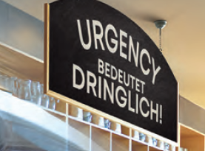
Make the urgent change with omvoh
Introduction
™
Omvoh (mirikizumab) is a first-in-class IL-23p19 antagonist to treat adult patients with moderately to severely active ulcerative colitis (UC)^{1,2}
INDICATION
Omvoh is indicated for the treatment of adult patients with moderately to severely active ulcerative colitis who have had an inadequate response with, lost response to, or were intolerant to either conventional therapy or a biologic treatment.
IL=interleukin; UC=ulcerative colitis.
Notes:
Speaker Notes:
Review topic of program with audience
References:
Omvoh Summary of Product Characteristics, Eli Lilly Nederland B.V., Utrecht, The Netherlands; 2023.
D’Haens G, Dubinsky M, Kobayashi T, et al. Mirikizumab as induction and maintenance therapy for ulcerative colitis. Draft Manuscript. 2023;(TK):TK-TK.

Slide 2
Overview
Program Disclosure
Addressing Questions
This program is sponsored by and presented on behalf of Eli Lilly and Company
The goal of the program is to review information pertinent to the topic and answer your on-label questions
Questions will be addressed during a question-and-answer session at the end of this presentation
Off-label questions will be addressed individually at a later time
Notes:
Speaker Notes:
This slide describes program disclosures and how questions will be addressed

Slide 3
ULCERATIVE COLITIS: Unmet Need
Disease State Background

Slide 4

UC symptoms and defining disease severity¹
Patients with UC may report:
According to ECCO, patients with moderate to severe UC:
Have stools with obvious blood or that are mostly blood
Abdominal pain
Rectal bleeding
Diarrhea
High stool frequency
Have more than 3 to 4 stools per day
Tenesmus
Fecal
incontinence
Have a Mayo endoscopic subscore of 2 to 3
Bowel urgency
Experience bowel urgency
Bowel urgency is not considered a specific treatment target in current practice, despite it being a common symptom of UC^{1,2}
ECCO=European Crohn's and Colitis Organisation; UC=ulcerative colitis.
Notes:
Claim TK
Speaker Notes:
While most UC symptoms involve the gastrointestinal system, additional symptoms can include fatigue, anorexia, and fever¹
ECCO defines clinical remission as stool frequency ≤3 per day, no rectal bleeding, and normal mucosa at endoscopy¹
Speaker Prompt: This is a chance to build your own case study–do you have a patient who exhibits some or all of these symptoms? Personalize the presentation with your own experience.
References:
Magro F, Gionchetti P, Eliakim R, et al. Third European evidence-based consensus on diagnosis and management of ulcerative colitis. Part 1: definitions, diagnosis, extra-intestinal manifestations, pregnancy, cancer surveillance, surgery, and ileo-anal pouch disorders. J Crohns Colitis. 2017;11(6):649-670. doi:10.1093/ecco-jcc/jjx008
Harbord M, Eliakim R, Bettenworth D, et al. Third European evidence-based consensus on diagnosis and management of ulcerative colitis. Part 2: current management. J Crohns Colitis. 2017;11(7):769-784. doi:10.1093/ecco-jcc/jjx009

Slide 5
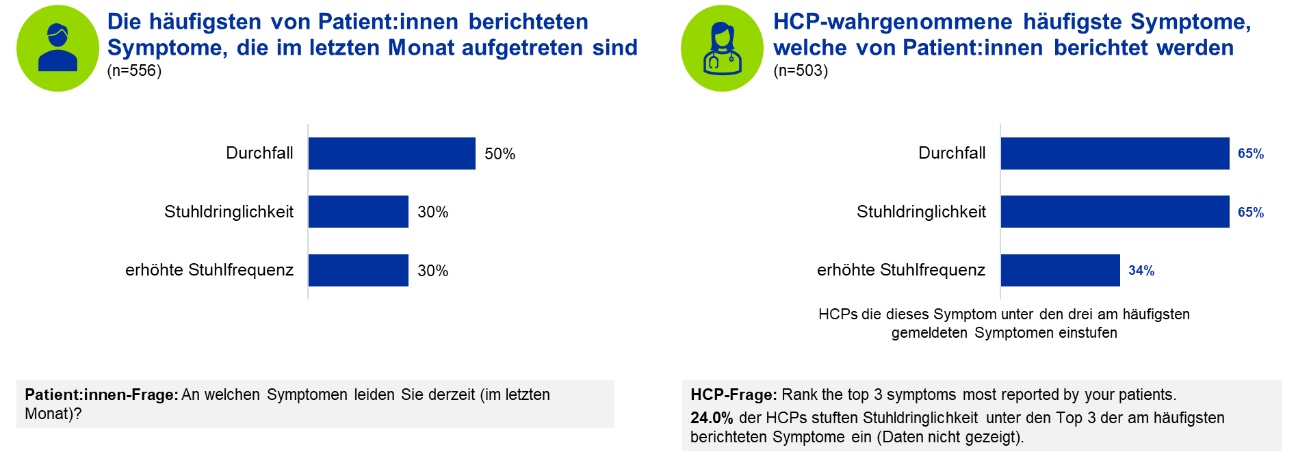
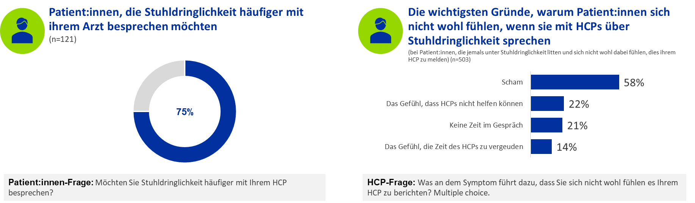
Conversation-Gap Bowel Urgency (Confide-Study)

Slide 6



Bowel urgency is one of the most disruptive symptoms for patients with UC¹
72%
(n=468/650)
43%
(n=86/200)
47%
(n=72/153)
of patients in an international study said bowel urgency had a high impact on their quality of life.²
of patients with moderately to severely active UC reported that bowel urgency led them to decline participation in social events.³
of patients on advanced therapy reported wearing a diaper, pad, or other protection at least once a week due to concern or anticipation
of a bowel urgency accident.⁴*
*Research findings from an online quantitative cross-sectional survey of patients with moderate to severe UC in the US in July 2021 (N=200). Advanced therapy=biologic or novel oral therapy; UC=ulcerative colitis.
Notes:
Speaker Notes
Bowel urgency is a common symptom, with 72% of patients reporting it had a high impact on their quality of life²
Even when on advanced therapy, nearly half of patients with UC wear a diaper or other protection at least once a week in anticipation of a bowel urgency accident⁴
Speaker Prompt: Do any of these stats surprise you or are they familiar? How do you talk to your patients about bowel urgency and other symptoms?
References:
Carpio D, López-Sanromán A, Calvet X, et al. Perception of disease burden and treatment satisfaction in patients with ulcerative colitis from outpatient clinics in Spain: UC-LIFE survey. Eur J Gastroenterol Hepatol. 2016;28(9):1056-1064. doi:10.1097/MEG.0000000000000658
Rubin DT, Sninsky C, Siegmund B, et al. International perspectives on management of inflammatory bowel disease: opinion differences and similarities between patients and physicians from the IBD GAPPS survey. Inflamm Bowel Dis. 2021;27(12):1942-1953. doi:10.1093/ibd/izab006
Dubinsky MC, Schreiber S, Potts Bleakman A, et al. P087 Communicating needs and features of IBD experiences (CONFIDE) survey: impact of ulcerative colitis symptoms on daily life. J Crohns Colitis. 2022;16(Suppl 1):i186-i187. doi:10.1093/ecco-jcc/jjab232.216
Schreiber S, Travis S, Potts Bleakman A, et al. Communicating needs and features of IBD experiences (CONFIDE) survey: burden and impact of bowel urgency on patients with moderate to severe ulcerative colitis. Gastroenterology. 2022;162:S79-S112. doi:10.1093/ibd/izac015.127

Slide 7
Non-Response and Loss of Response With Current Biologics
Targeted treatments have resulted in remission becoming an achievable goal in UC, but loss of response is high and one-third of patients on anti-TNF therapy experience a loss of response or intolerance to treatment¹
<50%
~20%
10-15%
of participants achieved long-term (52 weeks) clinical remission.²⁻⁴
of patients treated with anti-TNF therapy are primary nonresponders.⁵
per year potentially lose response to anti-TNF therapy after an initial benefit.⁵
This underscores the need for new therapeutic options for individuals with moderately to severely active UC
TNF=tumor necrosis factor; UC=ulcerative colitis.
Notes:
Claim TK
Speaker Notes:
Less than 50% of patients achieved long-term clinical remission with current UC therapy options²⁻⁴
Around 20% of patients do not respond to anti-TNF therapy (primary nonresponders)⁵
Additionally, 10-15% of patients lose response to anti-TNF therapy after an initial benefit (secondary nonresponders)⁵
References:
Gisbert JP, Marín AC, McNicholl AG, et al. Systematic review with meta-analysis: the efficacy of a second anti-TNF in patients with inflammatory bowel disease whose previous anti-TNF treatment has failed. Aliment Pharmacol Ther. 2015;41(7):613-623. doi:10.1111/apt.13083
Feagan BG, Rutgeerts P, Sands BE, et al. Vedolizumab as induction and maintenance therapy for ulcerative colitis. N Engl J Med. 2013;369(8):699-710. doi:10.1056/ NEJMoa1215734
Sands BE, Sandborn WJ, Panaccione R, et al. Ustekinumab as induction and maintenance therapy for ulcerative colitis. N Engl J Med. 2019;381(13):1201-1214. doi:10.1056/ NEJMoa1900750
Sandborn WJ, Su C, Sands BE, et al. Tofacitinib as induction and maintenance therapy for ulcerative colitis. N Engl J Med. 2017;376(18):1723-1736. doi:10.1056/NEJMoa1606910
Rubin DT, Ananthakrishnan AN, Siegel CA, Sauer BG, Long MD. ACG Clinical Guideline: ulcerative colitis in adults. Am J Gastroenterol. 2019;114(3):384-413. doi:10.14309/ ajg.0000000000000152

Slide 8

STRIDE II guidelines: Current treat-to-target strategy for UC¹
STRIDE II incorporates biomarker remission and QoL assessment into the targets below but excludes bowel urgency and histologic outcomes
Symptomatic
remission and normalization of CRP
Endoscopic healing, normalized QoL, and absence of disability
Additional considerations:
histologic healing
Symptomatic
response
Decrease in FCP to acceptable range
Active
disease
Therapy
according
to risk
TARGETS NOT REACHED
Short-term targets
Intermediate targets
Long-term targets
CRP=C-reactive protein; FCP=fecal calprotectin; QoL=quality of life; STRIDE=Selecting Therapeutic Targets in Inflammatory Bowel Disease; UC=ulcerative colitis.
Notes:
Claim TK
Speaker Notes:
For UC, the STRIDE-II guidelines are a well-known measure of progressive targets on a patient’s treatment journey¹
The short-term target of symptomatic response is based only on stool frequency and rectal bleeding¹
Bowel urgency is not considered in the current treat-to-target strategy, and histological healing is a potential long-term consideration but not a formal target¹
Clinical remission is a long-term goal that encompasses the targets listed on this slide; however, in clinical trials, the definition of clinical remission may need to be adapted to cover a shorter period of time¹
Reference:
Turner D, Ricciuto A, Lewis A, et al. STRIDE-II: an update on the Selecting Therapeutic Targets in Inflammatory Bowel Disease (STRIDE) initiative of the International Organization for the Study of IBD (IOIBD): determining therapeutic goals for treat-to-target strategies in IBD. Gastroenterology. 2021;160:1570-1583.

Slide 9
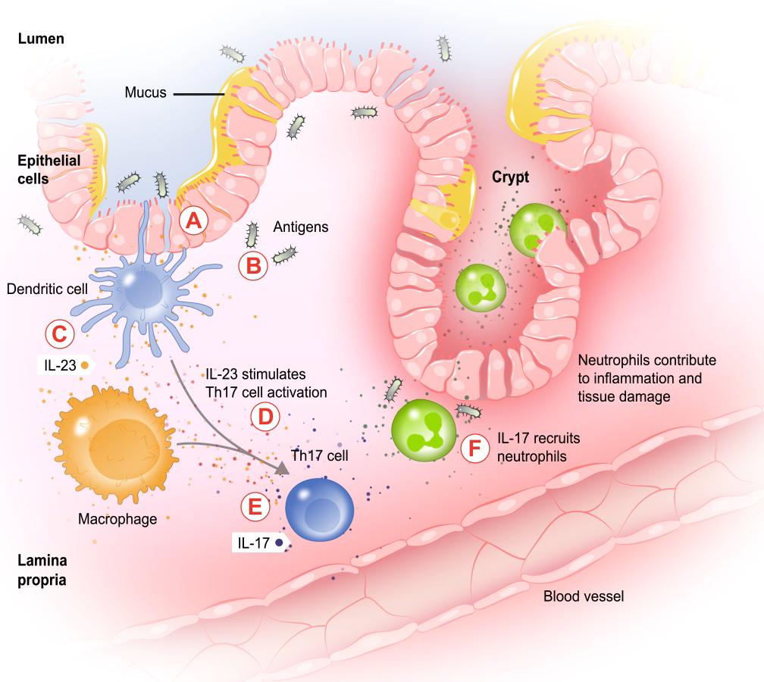

The IL-23 pathway plays an important role in UC^{1,2}
In UC there is exacerbated inflammation of the intestinal mucosa^{1,2}
IL-23 inflammatory cascade:
Weakening of the epithelial barrier
Translocation of luminal antigens and bacteria
Production of IL-23 in the mucosa
Amplification of Th17 cell differentiation
Production of IL-17 by Th17 cells
Neutrophil recruitment to the mucosa
IL=interleukin; Th=T helper; UC=ulcerative colitis.
Notes:
Claim TK
Speaker Notes:
At the cellular level, active disease results in exacerbated inflammation of the intestinal mucosa^{1,2}
This weakens the epithelial barrier and allows luminal antigens and bacteria to invade the mucosa
In response, cells in the mucosa produce IL-23, which amplifies Th17 cell differentiation; the Th17 cells then release IL-17^{1,2}
IL-17 is a cytokine involved in recruiting neutrophils to the mucosa, where neutrophils contribute to inflammation and tissue damage^{1,2}
References:
Neurath MF. Cytokines in inflammatory bowel disease. Nat Rev Immunol. 2014;14(5):329-342. doi:10.1038/nri3661
Neurath MF. IL-23 in inflammatory bowel diseases and colon cancer. Cytokine Growth Factor Rev. 2019;45:1-8. doi:10.1016/j.cytogfr.2018.12.002

Slide 10







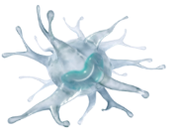
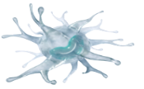



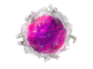
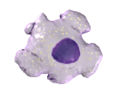
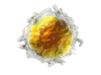
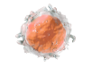
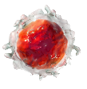
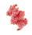

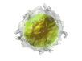
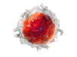
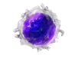
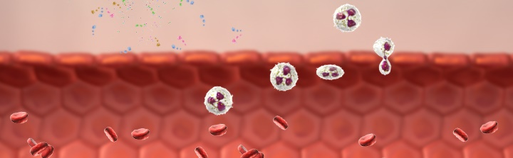
What Happens at a Cellular and Molecular Level in IBD?
10RC
Lumen
1
M cell
Enterocytes
1
Impaired barrier function due to initiating triggers
Mucus
Peyer’s patch
Dendritic cell
2
IL-12, IFNα, TNF
Translocation of bacteria and microbial products across the bowel wall leads to immune cell activation and cytokine production
TNF
Cytokine signaling
Paneth cells
T_{reg} cell
Naïve T cell
2
Lamina propria
CD8+ T cell
4
Activated macrophage
IL-23
3
CD4+ T cell
IL-12
Leukocytes from the blood are recruited
Chronic intestinal inflammation followed by tissue destruction
Th17 cell
Th1 cell
4
3
Blood vessel
Leukocyte
IFN=Interferon; IL=Interleukin; Th=T Helper; TNF=Tumor Necrosis Factor; Treg=T Regulatory. 1. Neurath MF. Nat Rev Immunol. 2014;14:329-342. 2. Van Rees EP, et al. Mediators Inflamm. 1997;6:85-93.
Internal Use
Notes:
Abbreviation(s):
IBD=Inflammatory Bowel Disease.
Reference(s):
Neurath MF. Cytokines in inflammatory bowel disease. Nat Rev Immunol. 2014;14:329-342.
Van Rees EP, Palmen MJ, Van De Goot FR, et al. Leukocyte migration in experimental inflammatory bowel disease. Mediators Inflamm. 1997;6:85-93.

Slide 11
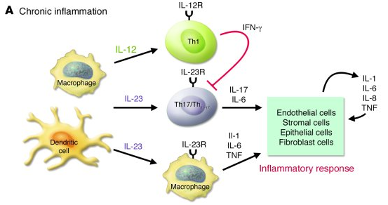
Cytokine Milieu in IBD Focus on the IL-23-Th17 Axis
10RR
Macrophages will release IL-12
IL-12 will activate Th1 (a subtype of T_{H})
Th1 will release IFN-γ
IFN-γ inhibits Th17 (another subtype of T_{H})
Dendritic Cells will release IL-23
IL-23 activates TH17
IL-23 stimulates Macrophages to release other cytokines
Th17 and Macrophages will release cytokines in response to cytokine signaling
Newly released cytokines will affect nearby cells to induce inflammation
Inflammation will induce more inflammatory cytokine release until an inhibitor is introduced to into the pathway
Neurath MF. Cytokines in inflammatory bowel disease. Nat Rev Immunol. 2014;14:329-342.
Internal Use
Notes:
Abbreviation(s):
CD=Crohn’s Disease; IBD=Inflammatory Bowel Disease.
Reference(s):
Neurath MF. Cytokines in inflammatory bowel disease. Nat Rev Immunol. 2014;14:329-342.

Slide 12
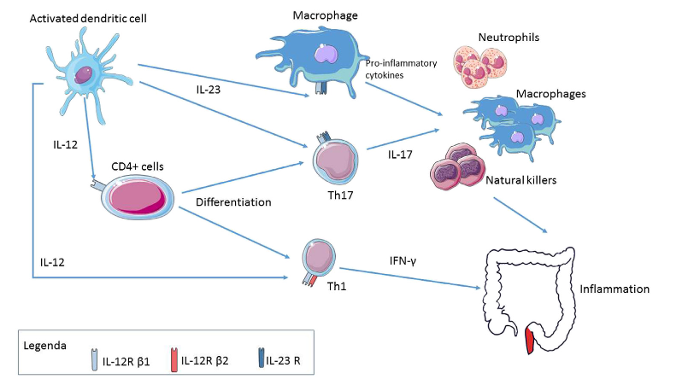
The IL-23 pathway plays an important role in UC^{1,2}
In UC there is exacerbated inflammation of the intestinal mucosa^{1,2}
IL-23 inflammatory cascade drives pro-inflammatory processes and Th17-differentiation
IL-12 leads to Th1 activation and IFN-γ production which inhibits Th17-proliferation and shows to be a potent inducer of antitumor immunity and to defend against bacterial and viral infections by augmenting host immunity^{2,3}
1.adapted from https://doi.org/10.1016/j.bpg.2018.05.016 2. Tugues S, et al. Cell Death Differ. 2015;22(2):237-246. 3. Hamza T, et al. Int J Mol Sci. 2010;11(3):789-806. IL=interleukin; Th=T helper; UC=ulcerative colitis.
12
Notes:
Claim TK
Speaker Notes:
At the cellular level, active disease results in exacerbated inflammation of the intestinal mucosa^{1,2}
This weakens the epithelial barrier and allows luminal antigens and bacteria to invade the mucosa
In response, cells in the mucosa produce IL-23, which amplifies Th17 cell differentiation; the Th17 cells then release IL-17^{1,2}
IL-17 is a cytokine involved in recruiting neutrophils to the mucosa, where neutrophils contribute to inflammation and tissue damage^{1,2}
References:
Neurath MF. Cytokines in inflammatory bowel disease. Nat Rev Immunol. 2014;14(5):329-342. doi:10.1038/nri3661
Neurath MF. IL-23 in inflammatory bowel diseases and colon cancer. Cytokine Growth Factor Rev. 2019;45:1-8. doi:10.1016/j.cytogfr.2018.12.002

Slide 13
IL-23 neu in der Gastroenterologie
Branded Info Starts

Slide 14

Omvoh—A first-in-class IL-23p19 antagonist for the treatment of moderately to severely active UC¹⁻³
Omvoh selectively targets the p19 subunit of IL-23 and inhibits the IL-23 pathway¹
Inflammation due to over-activation of the IL-23 pathway plays a critical role in the pathogenesis of UC¹
The IL-23 pathway is proposed to be a main driver in resistance against anti-TNF therapy^{Atreya et al.}
Omvoh spares the IL-12 pathway, preserving the protective role of IL-12 in immune responses^{1,4}
IL=interleukin; UC=ulcerative colitis.
Notes:
References:
Omvoh Summary of Product Characteristics, Eli Lilly Nederland B.V., Utrecht, The Netherlands; 2023.
PLACEHOLDER. Mirikizumab demonstrates superiority over placebo in phase 3 maintenance study in ulcerative colitis, supporting regulatory submissions in 2022. Eli Lilly and Company. December 14, 2021. Accessed May 18, 2022. https://investor.lilly.com/news-releases/news-release-details/mirikizumab-demonstrates-superiority-over-placebo-phase-3
Teng MW, Bowman EP, McElwee JJ, et al. IL-12 and IL-23 cytokines: from discovery to targeted therapies for immune-mediated inflammatory diseases. Nat Med. 2015;21(7):719-729. doi:10.1038.nm.3895
Hamza T, Barnett JB, Li B. Interleukin 12 a key immunoregulatory cytokine in infection applications. Int J Mol Sci. 2010;11(3):789-806. doi:10.3390/ijms11030789

Slide 15
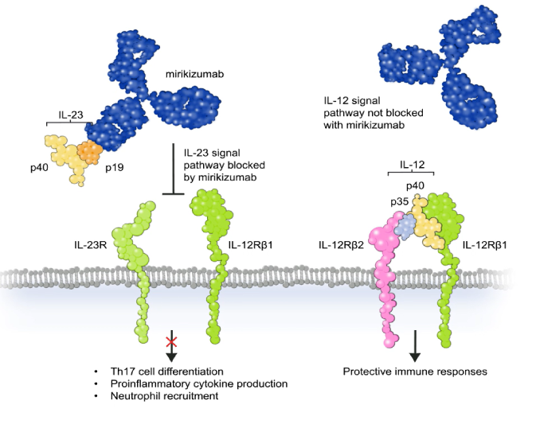
Omvoh—A first-in-class IL-23p19 antagonist for the treatment of moderately to severely active UC¹⁻³
Omvoh selectively targets the p19 subunit of IL-23 and inhibits the IL-23 pathway¹
Inflammation due to over-activation of the IL-23 pathway plays a critical role in the pathogenesis of UC¹
The IL-23 pathway is proposed to be a main driver in resistance against anti-TNF therapy^{Atreya et al.}
Omvoh spares the IL-12 pathway, preserving the protective role of IL-12 in immune responses^{1,4}
IL=interleukin; UC=ulcerative colitis.
Notes:
References:
Omvoh Summary of Product Characteristics, Eli Lilly Nederland B.V., Utrecht, The Netherlands; 2023.
PLACEHOLDER. Mirikizumab demonstrates superiority over placebo in phase 3 maintenance study in ulcerative colitis, supporting regulatory submissions in 2022. Eli Lilly and Company. December 14, 2021. Accessed May 18, 2022. https://investor.lilly.com/news-releases/news-release-details/mirikizumab-demonstrates-superiority-over-placebo-phase-3
Teng MW, Bowman EP, McElwee JJ, et al. IL-12 and IL-23 cytokines: from discovery to targeted therapies for immune-mediated inflammatory diseases. Nat Med. 2015;21(7):719-729. doi:10.1038.nm.3895
Hamza T, Barnett JB, Li B. Interleukin 12 a key immunoregulatory cytokine in infection applications. Int J Mol Sci. 2010;11(3):789-806. doi:10.3390/ijms11030789

Slide 16
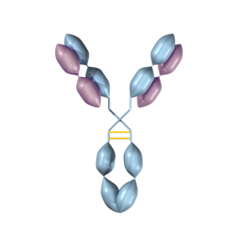
Mirikizumab - Onepager
NBD
Mechanism of Action
Anti-IL-23-Inhibitor-Antikörper¹
Gegen die p19 Untereinheit von IL-23 gerichtet¹
Hindert nicht die Bindung von IL-12 an seinen Rezeptor¹
Molekülcharakteristika
Humanisierter IgG4–variant monoklonaler Antikörper^{1,2}
Molekulargewicht 143.8 kDA²
Eigenschaften
Minimale Komplementaktivierung(C1q)^{3,4}
Geringe Affinität zur Aktivierung von Fcγ-Rezeptoren^{3,4}
Pharmacokinetik
Subkutane Bioverfügbarkeit = 40%⁵
Halbwertszeit (t_{1/2}) = 10.5 Tage⁵
IL-12
IL-23
p35
p40
p19
p40
IL-12Rβ2
IL-12Rβ1
IL-23R
IL-12Rβ1
IL-12 versus IL-23 signaling⁶
1. Sandborn WJ, et al. Gastroenterology. 2019; doi: 10.1053/j.gastro.2019.08.043. 2. USAN Council. Statement on a Nonproprietary Name Adopted by the USAN Council: Mirikizumab. 3. van der Neut Kolfschoten M, et al. Science. 2007;317:1554-1557. 4. Davies AM, Sutton BJ. Immunol Rev. 2015;268:139-159. 5. Maari C, et al. Presented at EADV 2016; Poster P0456. 6. Teng MW, et al. Nat Med. 2015;21:719-729.
External Use
Notes:
Abbreviations:
IgG4=Immunoglobulin G4; IL=Interleukin; K_{D}=Equilibrium Disassociation Constant; R=Receptor.
Notes:
Mirikizumab is an IgG4 monoclonal antibody. As an IgG4, it results in minimal activation of complement and has a low affinity for Fcγ receptors involved in stimulation of the immune system and antibody-dependent cellular cytotoxicity
Mirikizumab has a bioavailability of 40% and has a half-life of approximately 10.5 days
Mirikizumab is directed against the p19 subunit of IL-23 and therefore does not inhibit IL-12 binding to its receptor which has a common p40 subunit to IL-23
Source Information:
Sandborn WJ, Ferrante M, Bhandari BR, et al. Efficacy and safety of mirikizumab in a randomized phase 2 study of patients with ulcerative colitis. Gastroenterology. 2019; doi: 10.1053/j.gastro.2019.08.043 [Epub ahead of print].
The United States Adopted Names (USAN) Council. Statement on a Nonproprietary Name Adopted by the USAN Council: Mirikizumab. Available at: https://searchusan.ama-assn.org/undefined/documentDownload?uri=%2Funstructured%2Fbinary%2Fusan%2Fmirikizumab.pdf (Accessed October 2019).
van der Neut Kolfschoten M, Schuurman J, Losen M, et al. Anti-inflammatory activity of human IgG4 antibodies by dynamic Fab arm exchange. Science. 2007;317(5844):1554-1557 [page 1554].
Davies AM, Sutton BJ. Human IgG4: a structural perspective. Immunol Rev. 2015;268(1):139-159 [pages 143, 145, and 152].
Maari C, Bissonnette R, Papp K, et al. Safety, efficacy, and pharmacokinetics of a p19-directed IL-23 antibody in patients with plaque psoriasis and healthy subjects. Presented at the 25th European Association of Dermatology and Venerology (EADV) Congress, September 28-October 2, 2016, Vienna, Austria; Poster P0456.
Teng MW, Bowman EP, McElwee JJ, et al. IL-12 and IL-23 cytokines: from discovery to targeted therapies for immune-mediated inflammatory diseases. Nat Med. 2015;21(7):719-729 [page 721, figure 1].
QC completed by Remedica, October 10, 2019. Separate individuals at Remedica (on file) redrew the slide (October 10, 2019) and performed data review (October 10, 2019).
QC updated November 12, 2019.

Slide 17
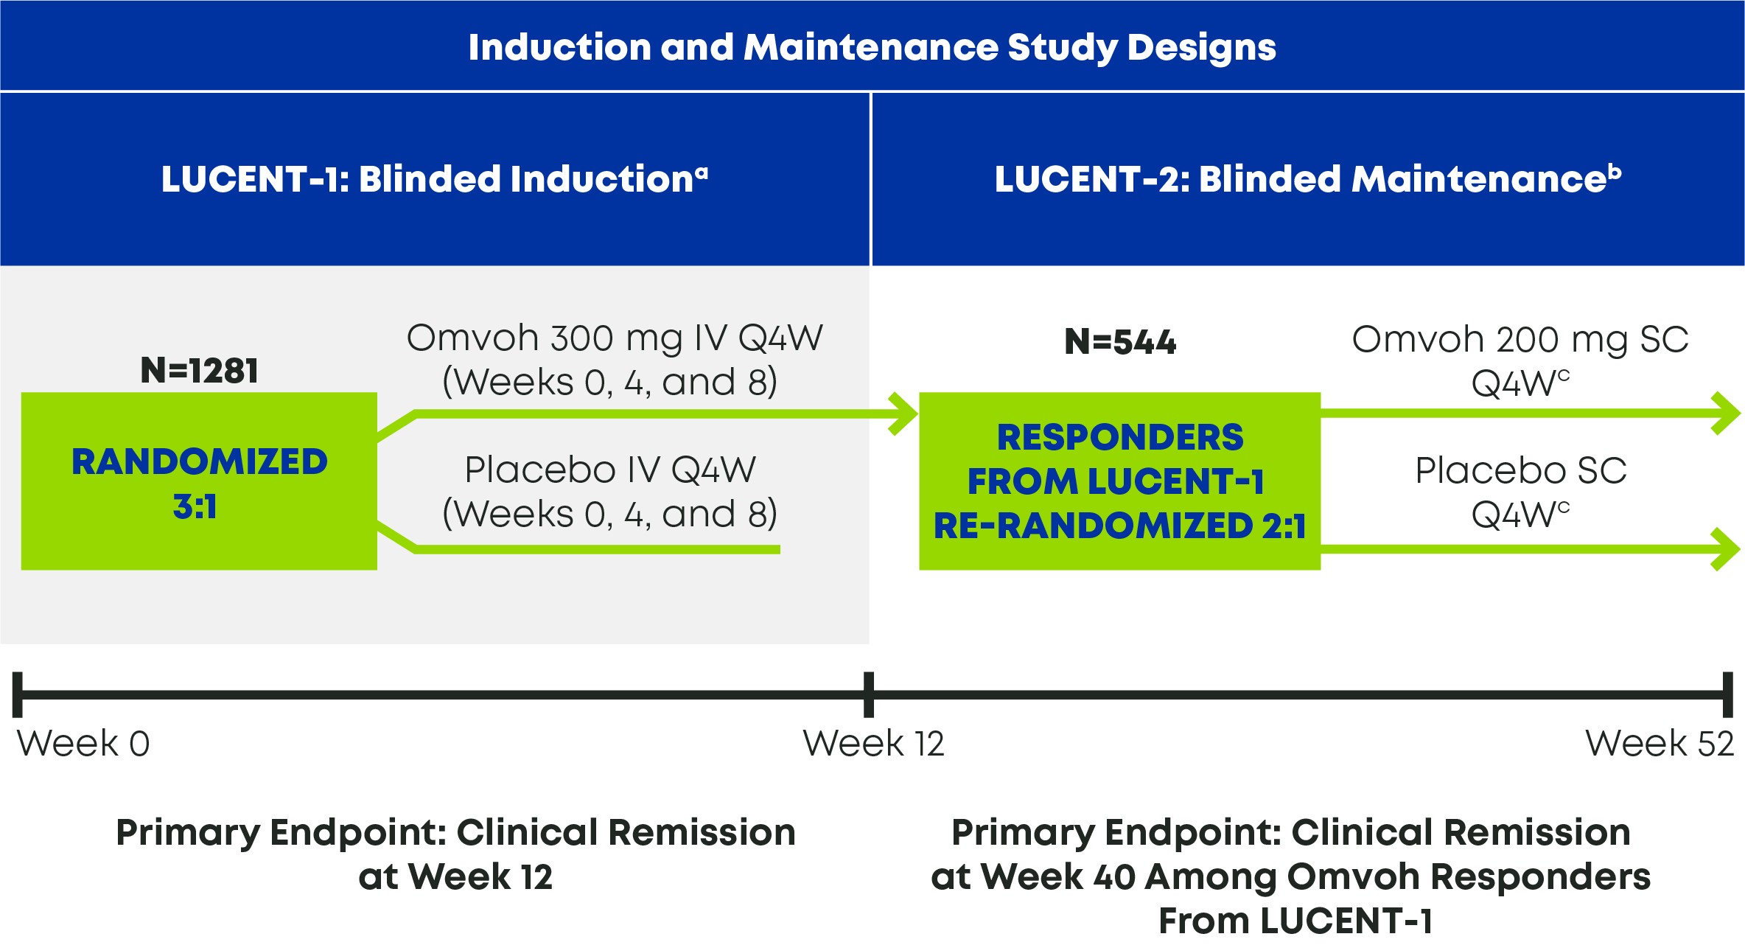
Evaluating the efficacy and safety of Omvoh in adult patients with moderately to severely active UC¹
Omvoh was evaluated in two Phase 3, randomized, double-blind, placebo-controlled clinical trials^{1,2}
At baseline, all patients had inadequate response, loss of response, or intolerance to at least one corticosteroid, immunomodulator, biologic treatment, or tofacitinib for UC¹
ªLUCENT-1 was a 12-week blinded induction study with patients randomized to Omvoh 300 mg IV or placebo IV every 4 weeks.¹
^{b}In LUCENT-2, patients who achieved clinical response with Omvoh in LUCENT-1 were re-randomized to Omvoh 200 mg SC or placebo SC every 4 weeks for an additional 40 weeks.^{1 c}Loss of response led to a reinitiating of open-label Omvoh 300 mg IV Q4W for 3 doses. Patients who did not experience clinical benefit discontinued Omvoh.^{1,2} IV=intravenous; Q4W=every 4 weeks; SC=subcutaneous; UC=ulcerative colitis.
Notes:
Speaker Notes:
Omvoh is given as three 300 mg intravenous (IV) induction doses, one every four weeks; after 12 weeks of induction, responders are shifted to maintenance doses of 200 mg every four weeks, given as two subsequent 100 mg subcutaneous (SC) injections¹
The design of the LUCENT-1 and LUCENT-2 trials reflects the different induction and maintenance doses¹
The secondary endpoints of LUCENT-1 were clinical response, endoscopic improvement, symptomatic remission at Weeks 4 and 12, histo-endoscopic mucosal improvement (HEMI), and bowel urgency severity¹
The placebo arm in LUCENT-2 comprises participants treated with Omvoh during the induction study (LUCENT-1) who were then re-randomized to receive placebo from Week 12 to Week 52 in LUCENT-2¹
The secondary endpoints of LUCENT-2 were endoscopic improvement, maintenance of clinical remission in participants who had achieved clinical remission at Week 12, corticosteroid-free remission, histo-endoscopic mucosal remission (HEMR), and bowel urgency severity¹
References:
Omvoh Summary of Product Characteristics, Eli Lilly Nederland B.V., Utrecht, The Netherlands; 2023.
D’Haens G, Dubinsky M, Kobayashi T, et al. Mirikizumab as induction and maintenance therapy for ulcerative colitis. Draft Manuscript. 2023;(TK):TK-TK.

Slide 18
Study Design LUCENT-1, LUCENT-2, and LUCENT-3
Primary Study Population
LUCENT-1
LUCENT-2
LUCENT-3^{b}
Blinded Induction
Maintenance/ Blinded Randomized Withdrawal (RW)
Open-Label (OL) Long-Term Extension
MIRI 200 SC Q4W
Rª
Randomization
2:1
OL MIRI 300 IV Q4W
MIRI 300 IV Q4W
PBO SC Q4W
OL MIRI 300 IV Q4W
OL MIRI 200 SC Q4W
Randomization 3:1
NR
OL MIRI 300 IV Q4W
OL MIRI 200 SC Q4W
Rollover for patients expected to benefit with continued MIRI Patients who lose response are rescued with OL MIRI
Rª
PBO SC Q4W
PBO IV Q4W
OL MIRI 300 IV Q4W
NR
OL MIRI 300 IV Q4W
OL MIRI 200 SC Q4W
//
W0
W12
W0
W12
W40
W0
W160
ªResponders at Week 12 of LUCENT-1 is defined as achieving ≥2-point and ≥30% decrease in the MMS from baseline with RB = 0 or 1, or ≥1-point decrease from baseline. ^{b}Includes patients originating in the Phase 2 study (AMAC); not shown. MMS=Modifed Mayo Score; NR=Nonresponder; R=Responder; RB=Rectal Bleeding Score. Data on File, Eli Lilly and Company.
Notes:
Abbreviation(s):
IV=Intravenous; SC = Subcutaneous; MIRI=Mirikizumab; PBO=Placebo; Q4W=Every 4 Weeks; SC=Subcutaneous.
Reference(s):
I6T-MC-AMAN Clinical Protocol [Sections 5.1 and 5.6, Pages 30–32].
I6T-MC-AMBG Clinical Protocol [Section 5.1, Pages 38-41].
I6T-MC-AMAP Clinical Protocol [Section 5.1, Pages 39-41].

Slide 19
Design des LUCENT-Programms LUCENT-Studienprogramm (3 von 3)
LUCENT-1
LUCENT-2
LUCENT-3^{b}
Verblindete Induktion
Erhaltung/ Verblindete randomisierte Absetzung (RW)
unverblindete Langzeitverlängerung (OLE)
MIRI 200 mg s.c. Q4W
Rª
Rerandomisierung
2:1
OL MIRI 200 mg s.c. Q4W
MIRI 300 mg i.v. Q4W
PBO s.c. Q4W
Randomisierung 3:1
NR
Bei Nicht-ansprechen durften Patient:innen noch 3mal 300mg IV Q4W Mirikizumab erhalten (extended Induction)
Rª
PBO i.v. Q4W
NR
//
W0
W12
W0
W12
W40
W0
W160
ªAnsprechen in Woche 12 von LUCENT-1 ist definiert als ≥2 Punkte und ≥30% Rückgang des MMS gegenüber Baseline mit RB = 0 oder 1 oder ≥1 Punkt Rückgang gegenüber Baseline. ^{b}Einschließlich Patienten aus der Phase-II-Studie (AMAC); nicht dargestellt. MMS=Modifizierter Mayo Score; NR=Nonresponder; R=Responder; RB=Subscore für rektale Blutungen. Dubinsky M et al. Oral Presentation at Digestive Disease Week 2022
INT-LI-AT-0001
Notes:
Abbreviation(s):
IV=Intravenous; SC = Subcutaneous; MIRI=Mirikizumab; PBO=Placebo; Q4W=Every 4 Weeks; SC=Subcutaneous.
Reference(s):
I6T-MC-AMAN Clinical Protocol [Sections 5.1 and 5.6, Pages 30–32].
I6T-MC-AMBG Clinical Protocol [Section 5.1, Pages 38-41].
I6T-MC-AMAP Clinical Protocol [Section 5.1, Pages 39-41].

Slide 20
LUCENT Program Design
Week 0
Week 12
Week 52
Week 212
LUCENT-1 (AMAN)
LUCENT-2 (AMBG)
LUCENT-3 (AMAP)
Responders: Randomized Withdrawal
Induction Study MIRI 300 mg IV Q4W PBO IV Q4W
Maintenance Study MIRI 200 mg SC Q4W PBO SC Q4W
Open-Label Extension Study MIRI 200 mg SC Q4W
Nonresponders: Extended Induction
If patient receiving clinical benefit from ongoing access to MIRI (in the opinion of investigator)
Extended Induction/ Open-Label Maintenance Arm within AMBG
Data on File, Eli Lilly and Company.
Notes:
Abbreviation(s):
IV=Intravenous; MIRI=Mirikizumab; PBO=Placebo; Q4W=Every 4 Weeks; SC=Subcutaneous.
Reference(s):
I6T-MC-AMAN Clinical Protocol [Sections 5.1 and 5.6, Pages 30–32].
I6T-MC-AMBG Clinical Protocol [Section 5.1, Pages 38-41].
I6T-MC-AMAP Clinical Protocol [Section 5.1, Pages 39-41].
QC completed by Remedica, February 26, 2021. Separate individuals at Remedica (on file) generated the slide (February 26, 2021) and performed data review (February 26, 2021).

Slide 21
LUCENT patient populations¹
Omvoh was studied in adult patients with moderately to severely active UC who had been treated with a prior conventional or biologic treatment
Moderately to severely active UC^{1,2}:
At baseline, patients had an MMS of 4 to 9, including an endoscopic subscore of 2 or 3
53% had severely active disease with an MMS of 7 to 9
Modified Mayo Score (MMS; summed, total of 0-9)
Stool frequency subscore | 0-3
Rectal bleeding subscore | 0-3
Endoscopic subscore | 0-3
Subscores range from 0 (normal) to 3 (most severe).
MMS=modified Mayo score; UC=ulcerative colitis.
Notes:
Speaker Notes:
Omvoh was studied in adult patients with moderately to severely active UC¹
The modified Mayo score (MMS) is used in clinical trials to measure disease activity, with a score of 4-6 indicating moderate UC and a score of 7-9 indicating severe UC²
An endoscopic subscore of 2 is defined by marked erythema, absent vascular pattern, friability and erosions; a subscore of 3 is defined by spontaneous bleeding and ulceration³
At baseline, 53% of patients had severely active disease (MMS of 7 to 9)¹
References:
Omvoh Summary of Product Characteristics, Eli Lilly Nederland B.V., Utrecht, The Netherlands; 2023.
Naegeli AN, Hunter T, Dong Y, et al. Full, partial, and modified permutations of the mayo score: characterizing clinical and patient-reported outcomes in ulcerative colitis patients. Crohns Colitis 360. 2021;3(1):1-8. doi:10.1093/crocol/otab007
Paine ER. Colonoscopic evaluation in ulcerative colitis. Gastroenterol Rep (Oxf). 2014;2(3):161-168. doi:10.1093/gastro/gou028

Slide 22
The Omvoh trials included patients who had been treated with a prior biologic and those who were bio-naive¹
% of Patients
41% of patients in LUCENT-1 and 35% of patients in LUCENT-2 had failed at least one prior biologic^{1,2}
LUCENT-1
LUCENT-2
Of the 361 Omvoh patients in LUCENT-1 who failed at least one prior biologic or tofacitinib³:
Of the 128 Omvoh patients in LUCENT-2 who failed at least one prior biologic or tofacitinib²:
9% (n=34/361) had prior tofacitinib failure
6% (n=8/128) had prior tofacitinib failure
44% (n=159/361) had prior vedolizumab failure
37% (n=47/128) had prior vedolizumab failure
90% (n=325/361) had prior anti-TNF failure
88% (n=112/128) had prior anti-TNF failure
Bio-failed=biologic-failed; bio-naive=biologic-naive; JAKi=Janus kinase inhibitor; TNF=tumor necrosis factor; UC=ulcerative colitis.
Notes:
Speaker Notes:
At the start of the first Phase 3 trial (LUCENT-1) 57% of participants were biologic and JAKi-naive, 41% had failed at least one biologic or tofacitinib¹
Of those who failed at least one prior biologic or tofacitinib in LUCENT-1, 9% had prior tofacitinib failure, 44% had prior vedolizumab failure, and 90% had prior anti-TNF failure³
In LUCENT-2, 6% had prior tofacitinib failure, 37% had prior vedolizumab failure, and 88% had prior anti-TNF failure²
Speaker Prompt: The study population includes patients who had previously failed a biologic, a population that may struggle to find a treatment that will work better for them. Does anyone in your practice—or the case study you built earlier—come to mind?
References:
Omvoh Summary of Product Characteristics, Eli Lilly Nederland B.V., Utrecht, The Netherlands; 2023.
D’Haens G, Dubinsky M, Kobayashi T, et al. Mirikizumab as induction and maintenance therapy for ulcerative colitis: supplementary appendix. Draft Manuscript. 2023;(TK):TK-TK.
D’Haens G, Dubinsky M, Kobayashi T, et al. Mirikizumab as induction and maintenance therapy for ulcerative colitis. Draft Manuscript. 2023;(TK):TK-TK.

Slide 23
Demografische Daten bei Baseline mITT-Population (LUCENT-1)
 | PBO N=294 | MIRI 300 i.v. N=868
Alter (Jahre), Mittelwert (SA) | 41,3 (13,8) | 42,9 (13,9)
Männlich, n (%) | 165 (56,1) | 530 (61,1)
Gewicht (kg); Mittelwert (SA) | 70,9 (16,7) | 72,6 (17,3)
Erkrankungsdauer der CU (Jahre), Mittelwert (SA) | 6,90 (6,95) | 7,16 (6,75)
Lokalisation der Erkrankung, n (%)
Proktitis | 2 (0,7) | 6 (0,7)
Linksseitige Kolitis | 188 (64,2) | 544 (62,7)
Pankolitis | 103 (35,2) | 318 (36,6)
Baseline-Kategorie des modifizierten Mayo Score, n (%)
Leicht (1–3) | 0 (0) | 1 (0,1)
Mäßig (4–6) | 138 (47,1) | 404 (46,5)
Schwer (7–9) | 155 (52,9) | 463 (53,3)
Gesamt-Mayo-Score, Mittelwert (SA) | 8,8 (1,56) | 8,8 (1,60)
Endoskopischer Mayo-Subscore, schwere Erkrankung (3), n (%) | 200 (68,3) | 574 (66,1)
Calprotectin im Stuhl (µg/g), Median (Q1; Q3) | 1471,5 (626,5; 2944,5) | 1559,0 (634,0; 3210,0)
D‘Haens G et al. Oral Presentation at ECCO 2022. Data on File bei Eli Lilly and Company.
Notes:
Abbreviation(s):
IV=Intravenous; MIRI=Mirikizumab; mITT=Modified Intent-to-Treat; PBO=Placebo; SD=Standard Deviation.
Reference(s):
/lillyce/prd/ly3074828/i6t_mc_aman/intrm1/output/restricted/tfl/t_dm_sum_mitt.rtf
QC completed by Lu Zhang (March 9, 2021).

Slide 24
Baseline und vorherige Colitis ulcerosa-Therapie mITT-Population (LUCENT-1)
 | PBO N=294 | MIRI 300 i.v. N=868
Einnahme von Kortikosteroiden bei Baseline, n (%) | 113 (38,4) | 351 (40,4)
Einnahme von Immunmodulatoren bei Baseline, n (%) | 69 (23,5) | 211 (24,3)
Versagen von Biologika oder Tofacitinib in der Vergangenheit, n (%) | 118 (40,1) | 361 (41,6)
Versagen von Anti-TNF in der Vergangenheit, n (%) | 97 (33,0) | 325 (37,4)
Versagen von Vedolizumab in der Vergangenheit, n (%) | 59 (20,1) | 159 (18,3)
Versagen von Tofacitinib in der Vergangenheit, n (%) | 6 (2,0) | 34 (3,9)
Anzahl versagter Biologika oder Tofacitinib, n (%)
Keine | 176 (59,9) | 507 (58,4)
1 | 65 (22,1) | 180 (20,7)
2 | 49 (16,7) | 154 (17,7)
≥3 | 4 (1,4) | 27 (3,1)
D‘Haens G et al. Oral Presentation at ECCO 2022.
Notes:
Abbreviation(s):
IV=Intravenous; MIRI=Mirikizumab; mITT=Modified Intent-to-Treat; PBO=Placebo; SD=Standard Deviation.
Reference(s):
/lillyce/prd/ly3074828/i6t_mc_aman/intrm1/output/restricted/tfl/t_dm_sum_mitt.rtf
QC completed by Lu Zhang (March 9, 2021).

Slide 25
LUCENT-1 INDUCTION TRIAL
Induction Efficacy

Slide 26




Endpoint definitions from LUCENT-1¹
INDUCTION STUDY
PRIMARY ENDPOINT: CLINICAL REMISSION
Key secondary ENDPOINT: CLINICAL response
STOOL FREQUENCY SUBSCORE = 0 or 1 with a ≥1-point decrease from baseline
MODIFIED MAYO SCOREª
≥2 points and ≥30% decrease from baseline
+
+
RECTAL BLEEDING SUBSCORE = 0
RECTAL BLEEDING SUBSCORE = 0 or 1, or a ≥1-point decrease from baseline
+
ENDOSCOPIC SUBSCORE = 0 or 1
(excluding friability)
Note: Only Omvoh responders from the induction trial moved to the maintenance trial.
ªThe modified Mayo Score is composed of 3 categories (rectal bleeding, stool frequency, and centrally assessed endoscopy) rated from 0-3, which are summed to give a total score that ranges between 0-9, with a higher score indicating worse severity.^{1,2}
Notes:
Claim TK
Speaker Notes:
The Mayo score is composed of four categories (bleeding, stool frequency, physician assessment, and endoscopic appearance) rated from 0–3 that are summed to give a total score that ranges from 0–12, with higher scores indicating worse severity²
The modified Mayo Score (MMS) ranges from 0-9 and omits the physician assessment²
In the induction trial (LUCENT-1), clinical remission and clinical response endpoints were based on the patients’ MMS¹
References:
Omvoh Summary of Product Characteristics, Eli Lilly Nederland B.V., Utrecht, The Netherlands; 2023.
Naegeli AN, Hunter T, Dong Y, et al. Full, partial, and modified permutations of the mayo score: characterizing clinical and patient-reported outcomes in ulcerative colitis patients. Crohns Colitis 360. 2021;3(1):1-8. doi:10.1093/crocol/otab007

Slide 27
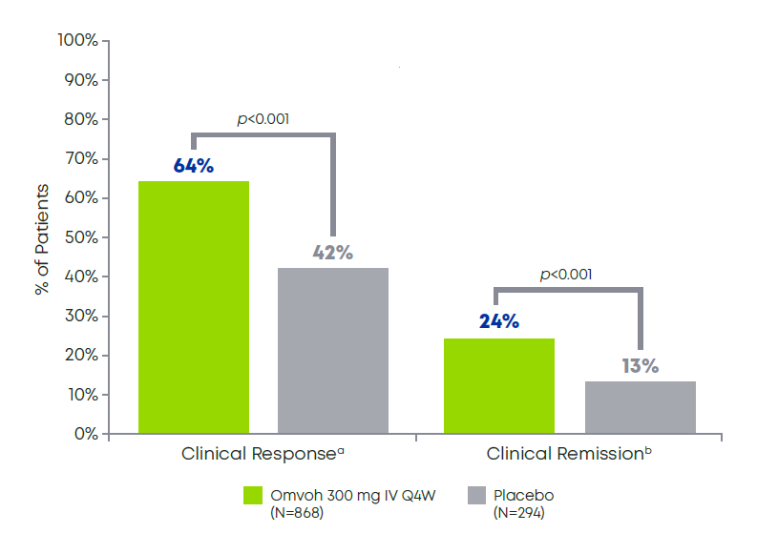
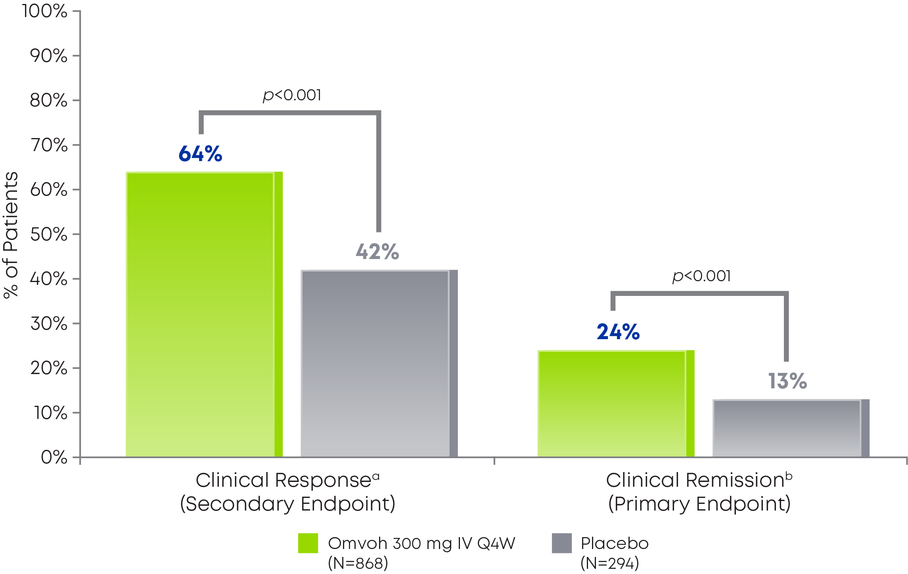
Achieve clinical response and remission after 12 weeks with Omvoh¹
INDUCTION STUDY
Clinical Responseª and Clinical Remission^{b} at Week 12¹
64% of patients taking Omvoh achieved clinical response after 12 weeks of induction dosing, and nearly 1 in 4 achieved clinical remission¹
See study design on slide 11.
ªClinical response was defined as a decrease in the MMS of ≥2 points and ≥30% decrease from baseline; RB=0 or 1, or a ≥1-point decrease from baseline.¹
^{b}Clinical remission was defined as SF=0 or 1 with a ≥1-point decrease from baseline, and RB=0, and ES=0 or 1 (excluding friability).¹
ES=endoscopic subscore; IV=intravenous; MMS=modified Mayo Score; Q4W=every 4 weeks; RB=rectal bleeding subscore; SF=stool frequency subscore.
Notes:
Speaker Notes:
64% of patients taking Omvoh achieved clinical response after 12 weeks of induction dosing¹
24% of patients taking Omvoh achieved clinical remission in the same time period¹
Reference:
Omvoh Summary of Product Characteristics, Eli Lilly Nederland B.V., Utrecht, The Netherlands; 2023.

Slide 28
Primärer Endpunkt: Klinische Remission in Woche 12 Induktionsphase, mITT-Population (LUCENT-1), NRI
Klinische Remission: SF = 0, oder SF = 1 mit einer Abnahme von ≥1 Punkt gegenüber Baseline; RB = 0; ES = 0 oder 1 (ohne Schleimhautvulnerabilität)
PBO
MIRI 300 mg
p=0,00006
p<0,001
p=0,065
Rate (99,875 %-KI)
Rate (95 %-KI)
30,9
24,2
13,3
15,8
15,2
8,5
N
294
868
171
492
118
361
INT-LI-AT-0001
ªEinschließlich Patienten mit Tofacitinib-Versagen. ES=Endoskopischer Subscore; RB=Subscore für rektale Blutungen; SF=Subscore für die Stuhlfrequenz. D‘Haens G et al. Oral Presentation at ECCO 2022.
Notes:
Abbreviation(s):
CI=Confidence Interval; IV=Intravenous; MIRI=Mirikizumab; mITT=Modified Intent-to-Treat; NRI=Nonresponder Imputation; PBO=Placebo.
Reference(s):
/lillyce/prd/ly3074828/i6t_mc_aman/intrm1/output/restricted/tfl/t_a_qs_mclnrem_nri_mitt_i.rtf
/lillyce/prd/ly3074828/i6t_mc_aman/intrm1/output/restricted/tfl/t_a_qs_clnrem_subgp_priuc_nri_mitt_i.rtf
QC completed by Lu Zhang (March 9, 2021).

Slide 29
Klinisches Ansprechen in Woche 12 Induktionsphase, mITT-Population (LUCENT-1), NRI
Klinisches Ansprechen:
≥2 Punkte und ≥30% Abnahme des MMS gegenüber Baseline; RB = 0 oder 1 oder eine Abnahme um ≥1 Punkt gegenüber Baseline
PBO
MIRI 300 mg
p<0,00001
p<0,001
p<0,001
70,1
63,5
50,3
54,6
42,2
Ansprechrate (99,875 %-KI)
Ansprechrate (95 %-KI)
29,7
N
294
868
171
492
118
361
INT-LI-AT-0001
ªEinschließlich Patienten mit Tofacitinib-Versagen. MMS=Modifizierter Mayo-Score; RB=Subscore für rektale Blutungen. D‘Haens G et al. Oral Presentation at ECCO 2022.
Notes:
Abbreviation(s):
CI=Confidence Interval; IV=Intravenous; MIRI=Mirikizumab; mITT=Modified Intent-to-Treat; NRI=Nonresponder Imputation; PBO=Placebo.
Reference(s):
/lillyce/prd/ly3074828/i6t_mc_aman/intrm1/output/restricted/tfl/t_a_qs_cln_resprt_nri_mitt_i.rtf
/lillyce/prd/ly3074828/i6t_mc_aman/intrm1/output/restricted/tfl/t_a_qs_cln_resprt_subgp_priuc_nri_mitt_i.rtf
QC completed by Lu Zhang (March 9, 2021).

Slide 30
Endoskopische Remission in Woche 12 Induktionsphase, mITT-Population (LUCENT-1), NRI
PBO
MIRI 300 mg
Endoskopische Remission: ES = 0 oder 1 (ohne Schleimhautvulnerabilität)
p<0,00001
p<0,001
p<0,001
45,4
Ansprechrate (99,875 %-KI)
36,3
Ansprechrate (95 %-KI)
21,1
28,4
23,5
10,2
N
294
868
176
118
507
361
INT-LI-AT-0001
ªEinschließlich Patienten mit Tofacitinib-Versagen. ES=Endoskopischer Subscore. D‘Haens G et al. Oral Presentation at ECCO 2022. Data on File bei Eli Lilly and Company.
Notes:
Abbreviation(s):
CI=Confidence Interval; IV=Intravenous; MIRI=Mirikizumab; mITT=Modified Intent-to-Treat; NRI=Nonresponder Imputation; PBO=Placebo.
Reference(s):
/lillyce/prd/ly3074828/i6t_mc_aman/intrm1/output/restricted/tfl/t_a_qs_endsp_remrt_nri_mitt_i.rtf
/lillyce/prd/ly3074828/i6t_mc_aman/intrm1/output/restricted/tfl/t_a_qs_endsp_remrt_subgp_priuc_nri_mitt_i.rtf
QC completed by Lu Zhang (March 9, 2021).

Slide 31
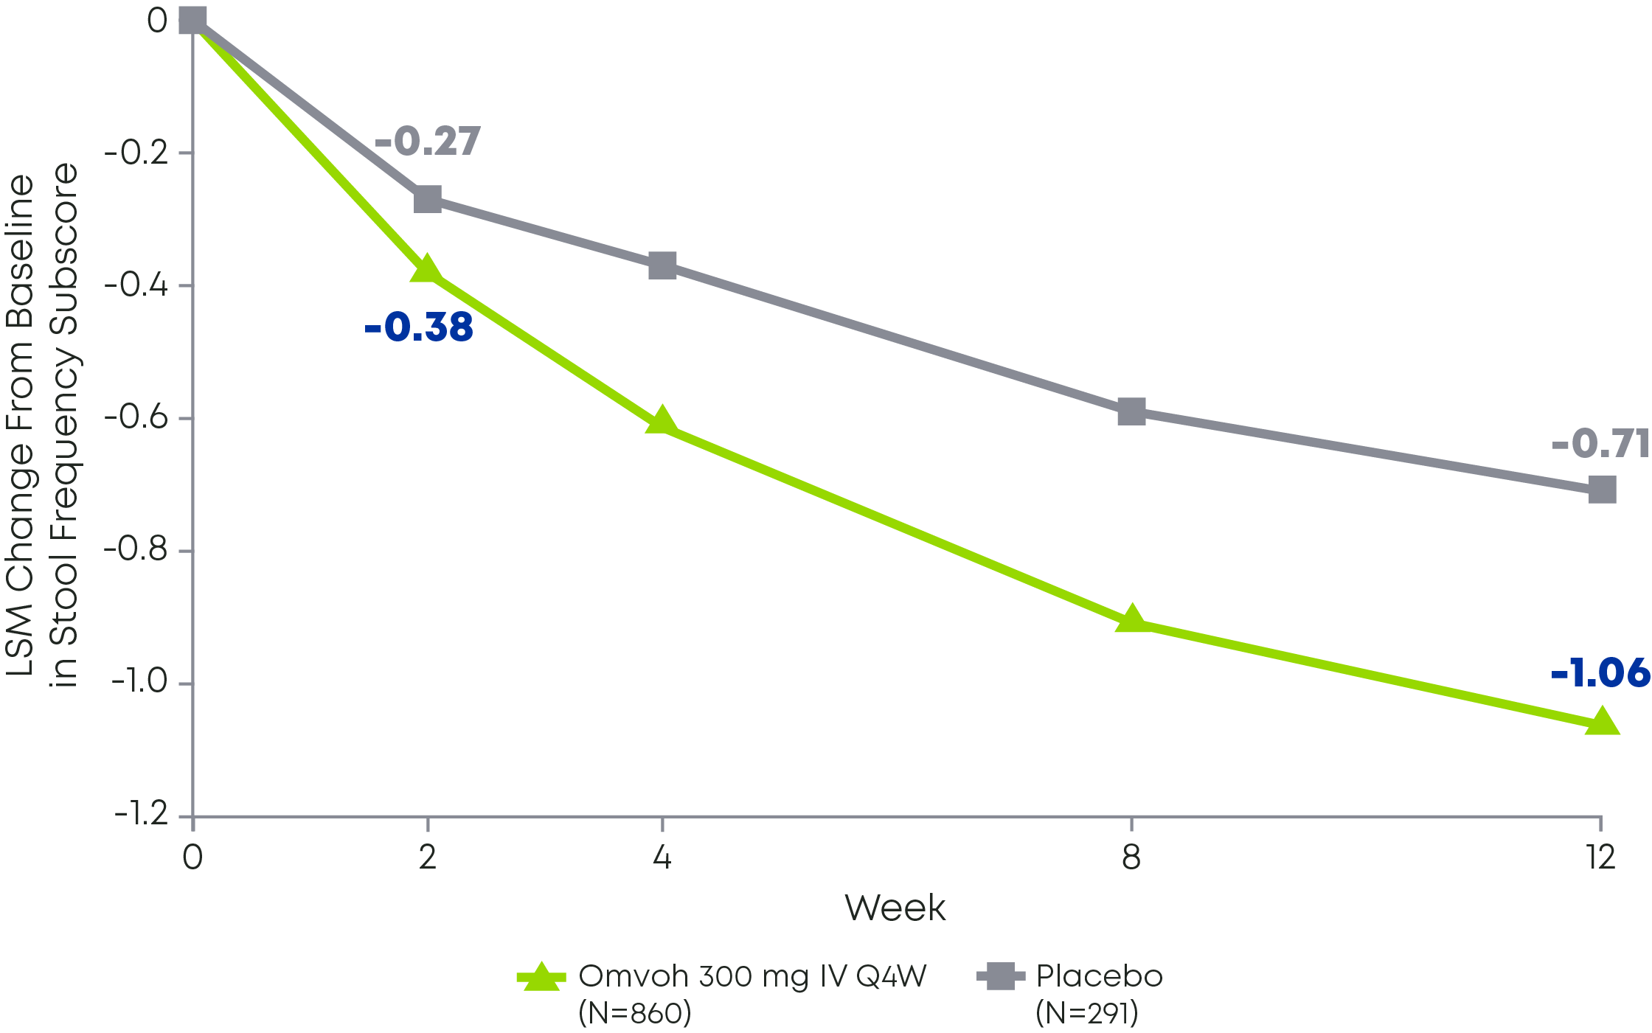
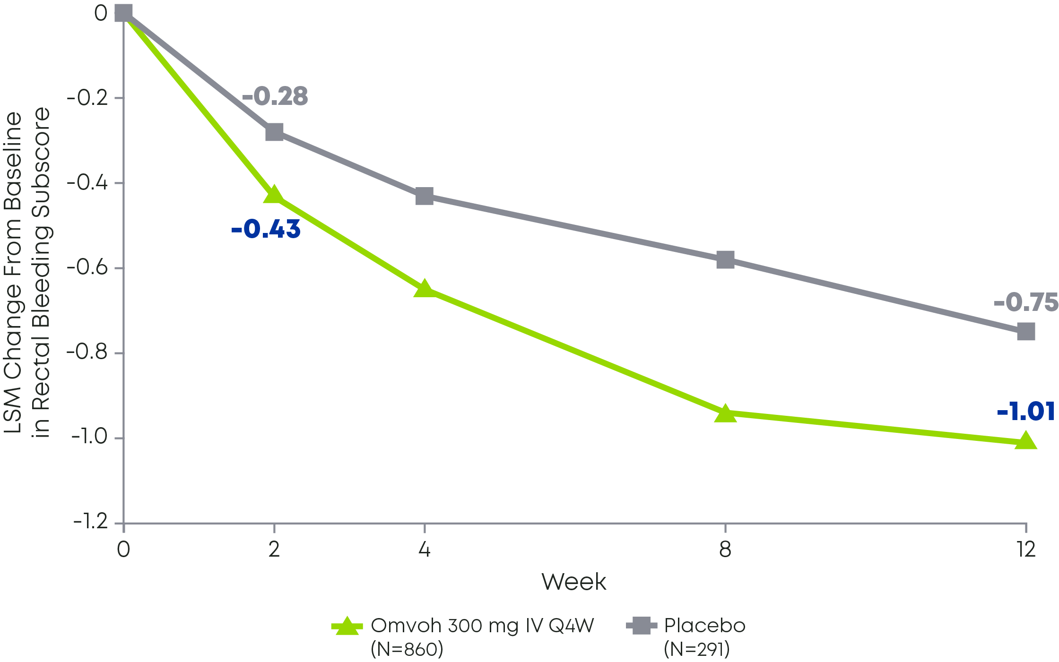
Omvoh provided rapid relief of UC symptoms as early as Week 2¹
INDUCTION STUDY
Stool Frequency Subscore
Through Week 12^{2a}
Rectal Bleeding Subscore
Through Week 12^{3a}
See study design on slide 11.
Primary endpoint was clinical remission at Week 12 in LUCENT-1 and Week 40 in LUCENT-2. Clinical remission based on MMS is defined as: SF=0 or 1 with a ≥1-point decrease from baseline, and RB=0, and ES=0 or 1 (excluding friability).^{1 a}Prespecified analysis not controlled for multiplicity. ES=endoscopic subscore; IV=intravenous; LSM=least squares mean; MMS=modified Mayo score; Q4W=every 4 weeks; RB=rectal bleeding subscore; SF=stool frequency subscore; UC=ulcerative colitis.
Notes:
Speaker Notes:
There was a rapid response after even the first induction dose¹
Decreases in UC symptoms (rectal bleeding and stool frequency subscores) were observed as early as Week 2 with Omvoh¹
UC symptoms continued to improve throughout the induction period¹
References:
Omvoh Summary of Product Characteristics, Eli Lilly Nederland B.V., Utrecht, The Netherlands; 2023.
Data on file, Lilly USA, LLC, DOF-MR-US-0013.
Data on file, Lilly USA, LLC, DOF-MR-US-0012.

Slide 32
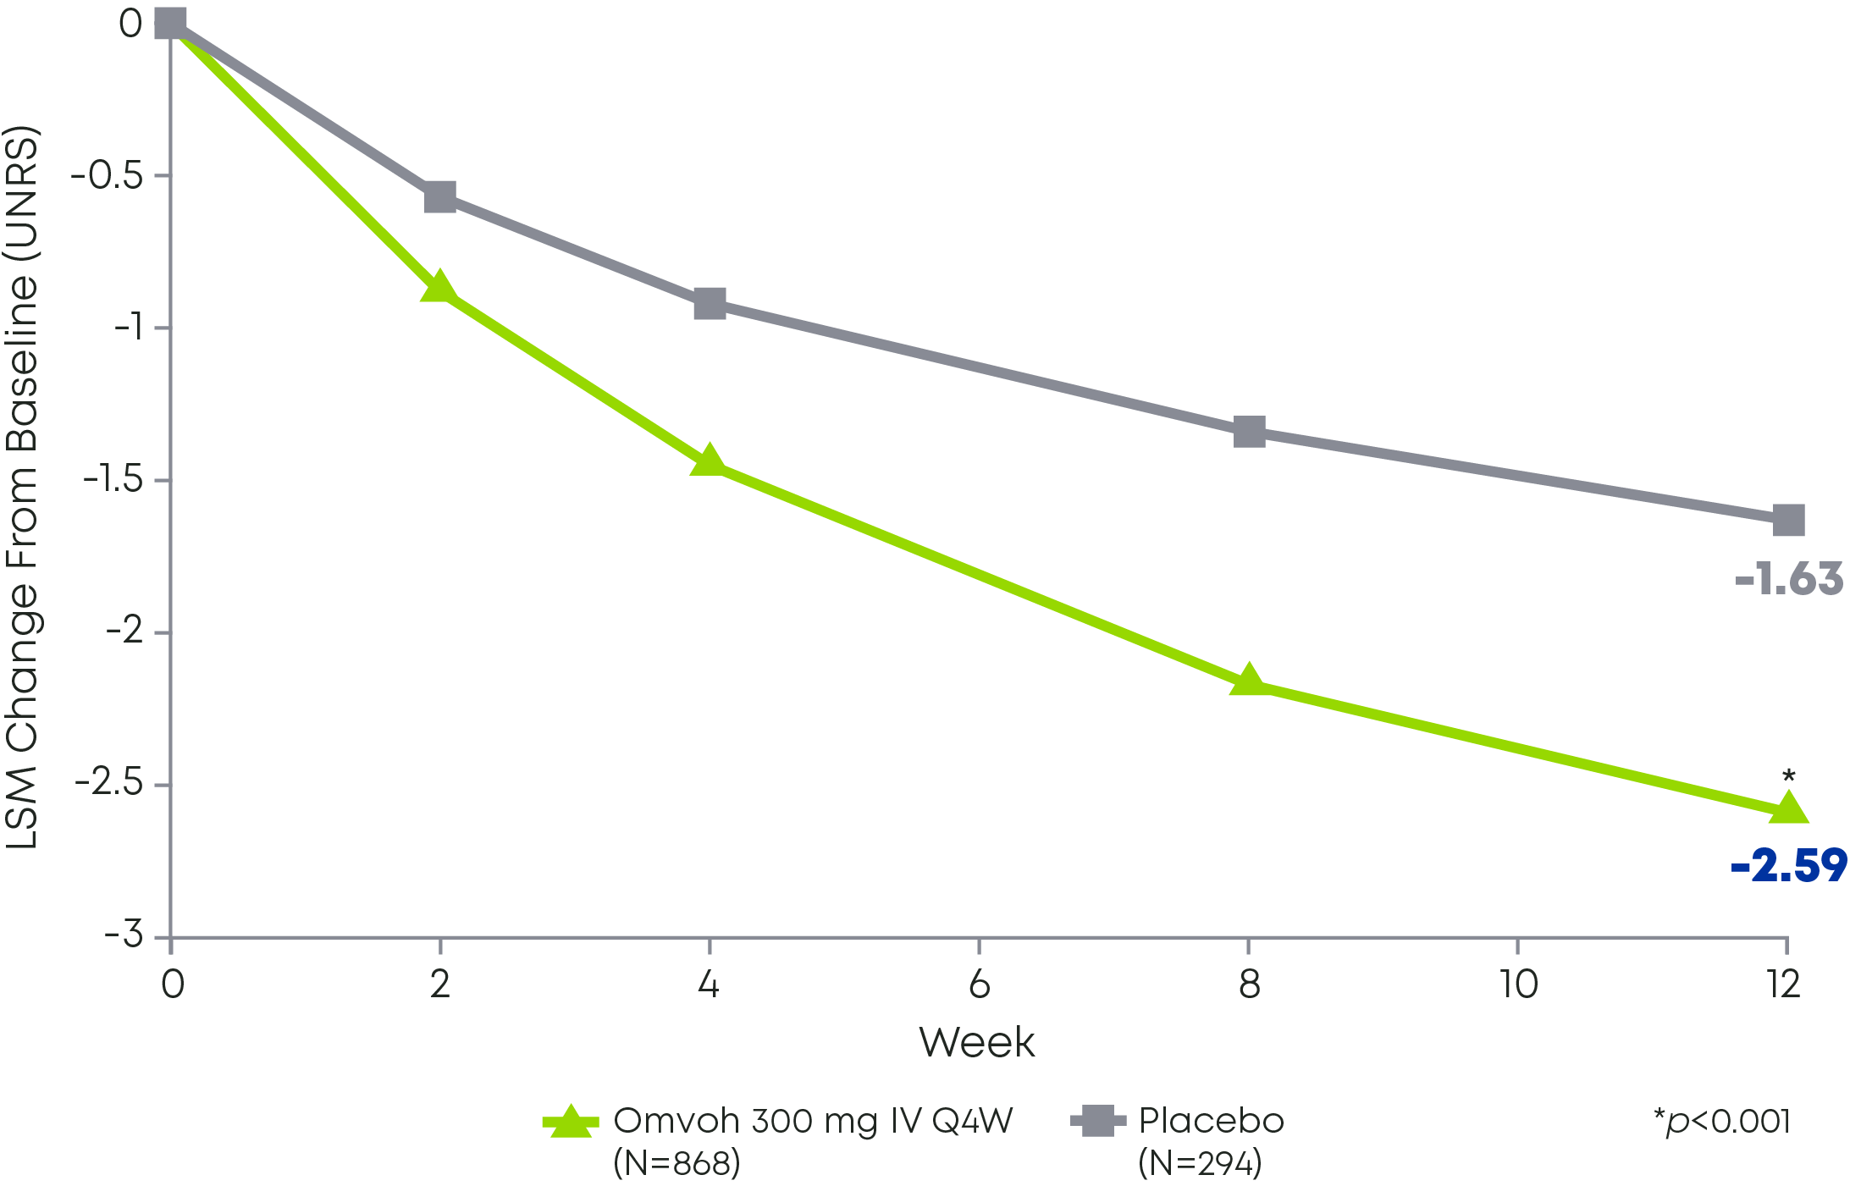
Omvoh provided rapid relief of UC symptoms as early as Week 2¹
INDUCTION STUDY
Stool Frequency Subscore Through Week 12^{2a}
Rectal Bleeding Subscore Through Week 12^{3a}
Change in Bowel Urgency Severity^{1,2b}
Primary endpoint was clinical remission at Week 12 in LUCENT-1 and Week 40 in LUCENT-2. Clinical remission based on MMS is defined as: SF=0 or 1 with a ≥1-point decrease from baseline, and RB=0, and ES=0 or 1 (excluding friability).^{1 a}Prespecified analysis not controlled for multiplicity. ^{b}Bowel urgency severity estimated by LSM change from baseline in the UNRS score (0 indicates no urgency, 10 indicates worst possible urgency).1,3 ES=endoscopic subscore; IV=intravenous; LSM=least squares mean; MMS=modified Mayo score; Q4W=every 4 weeks; RB=rectal bleeding subscore; SF=stool frequency subscore; UC=ulcerative colitis; UNRS=Urgency Numeric Rating Scale.
Notes:
Speaker Notes:
There was a rapid response after even the first induction dose¹
Decreases in UC symptoms (rectal bleeding and stool frequency subscores) were observed as early as Week 2 with Omvoh¹
UC symptoms continued to improve throughout the induction period¹
References:
Omvoh Summary of Product Characteristics, Eli Lilly Nederland B.V., Utrecht, The Netherlands; 2023.
Data on file, Lilly USA, LLC, DOF-MR-US-0013.
Data on file, Lilly USA, LLC, DOF-MR-US-0012.

Slide 33
LUCENT-2 MAINTENANCE TRIAL
52-Week Efficacy

Slide 34
Responders from the LUCENT-1 trial were re-randomized for LUCENT-2, the maintenance study^{1,2}
IV=intravenous; Q4W=every 4 weeks; SC=subcutaneous.
Notes:
References:
Omvoh Summary of Product Characteristics, Eli Lilly Nederland B.V., Utrecht, The Netherlands; 2023.
D’Haens G, Dubinsky M, Kobayashi T, et al. Mirikizumab as induction and maintenance therapy for ulcerative colitis. Draft Manuscript. 2023;(TK):TK-TK.

Slide 35
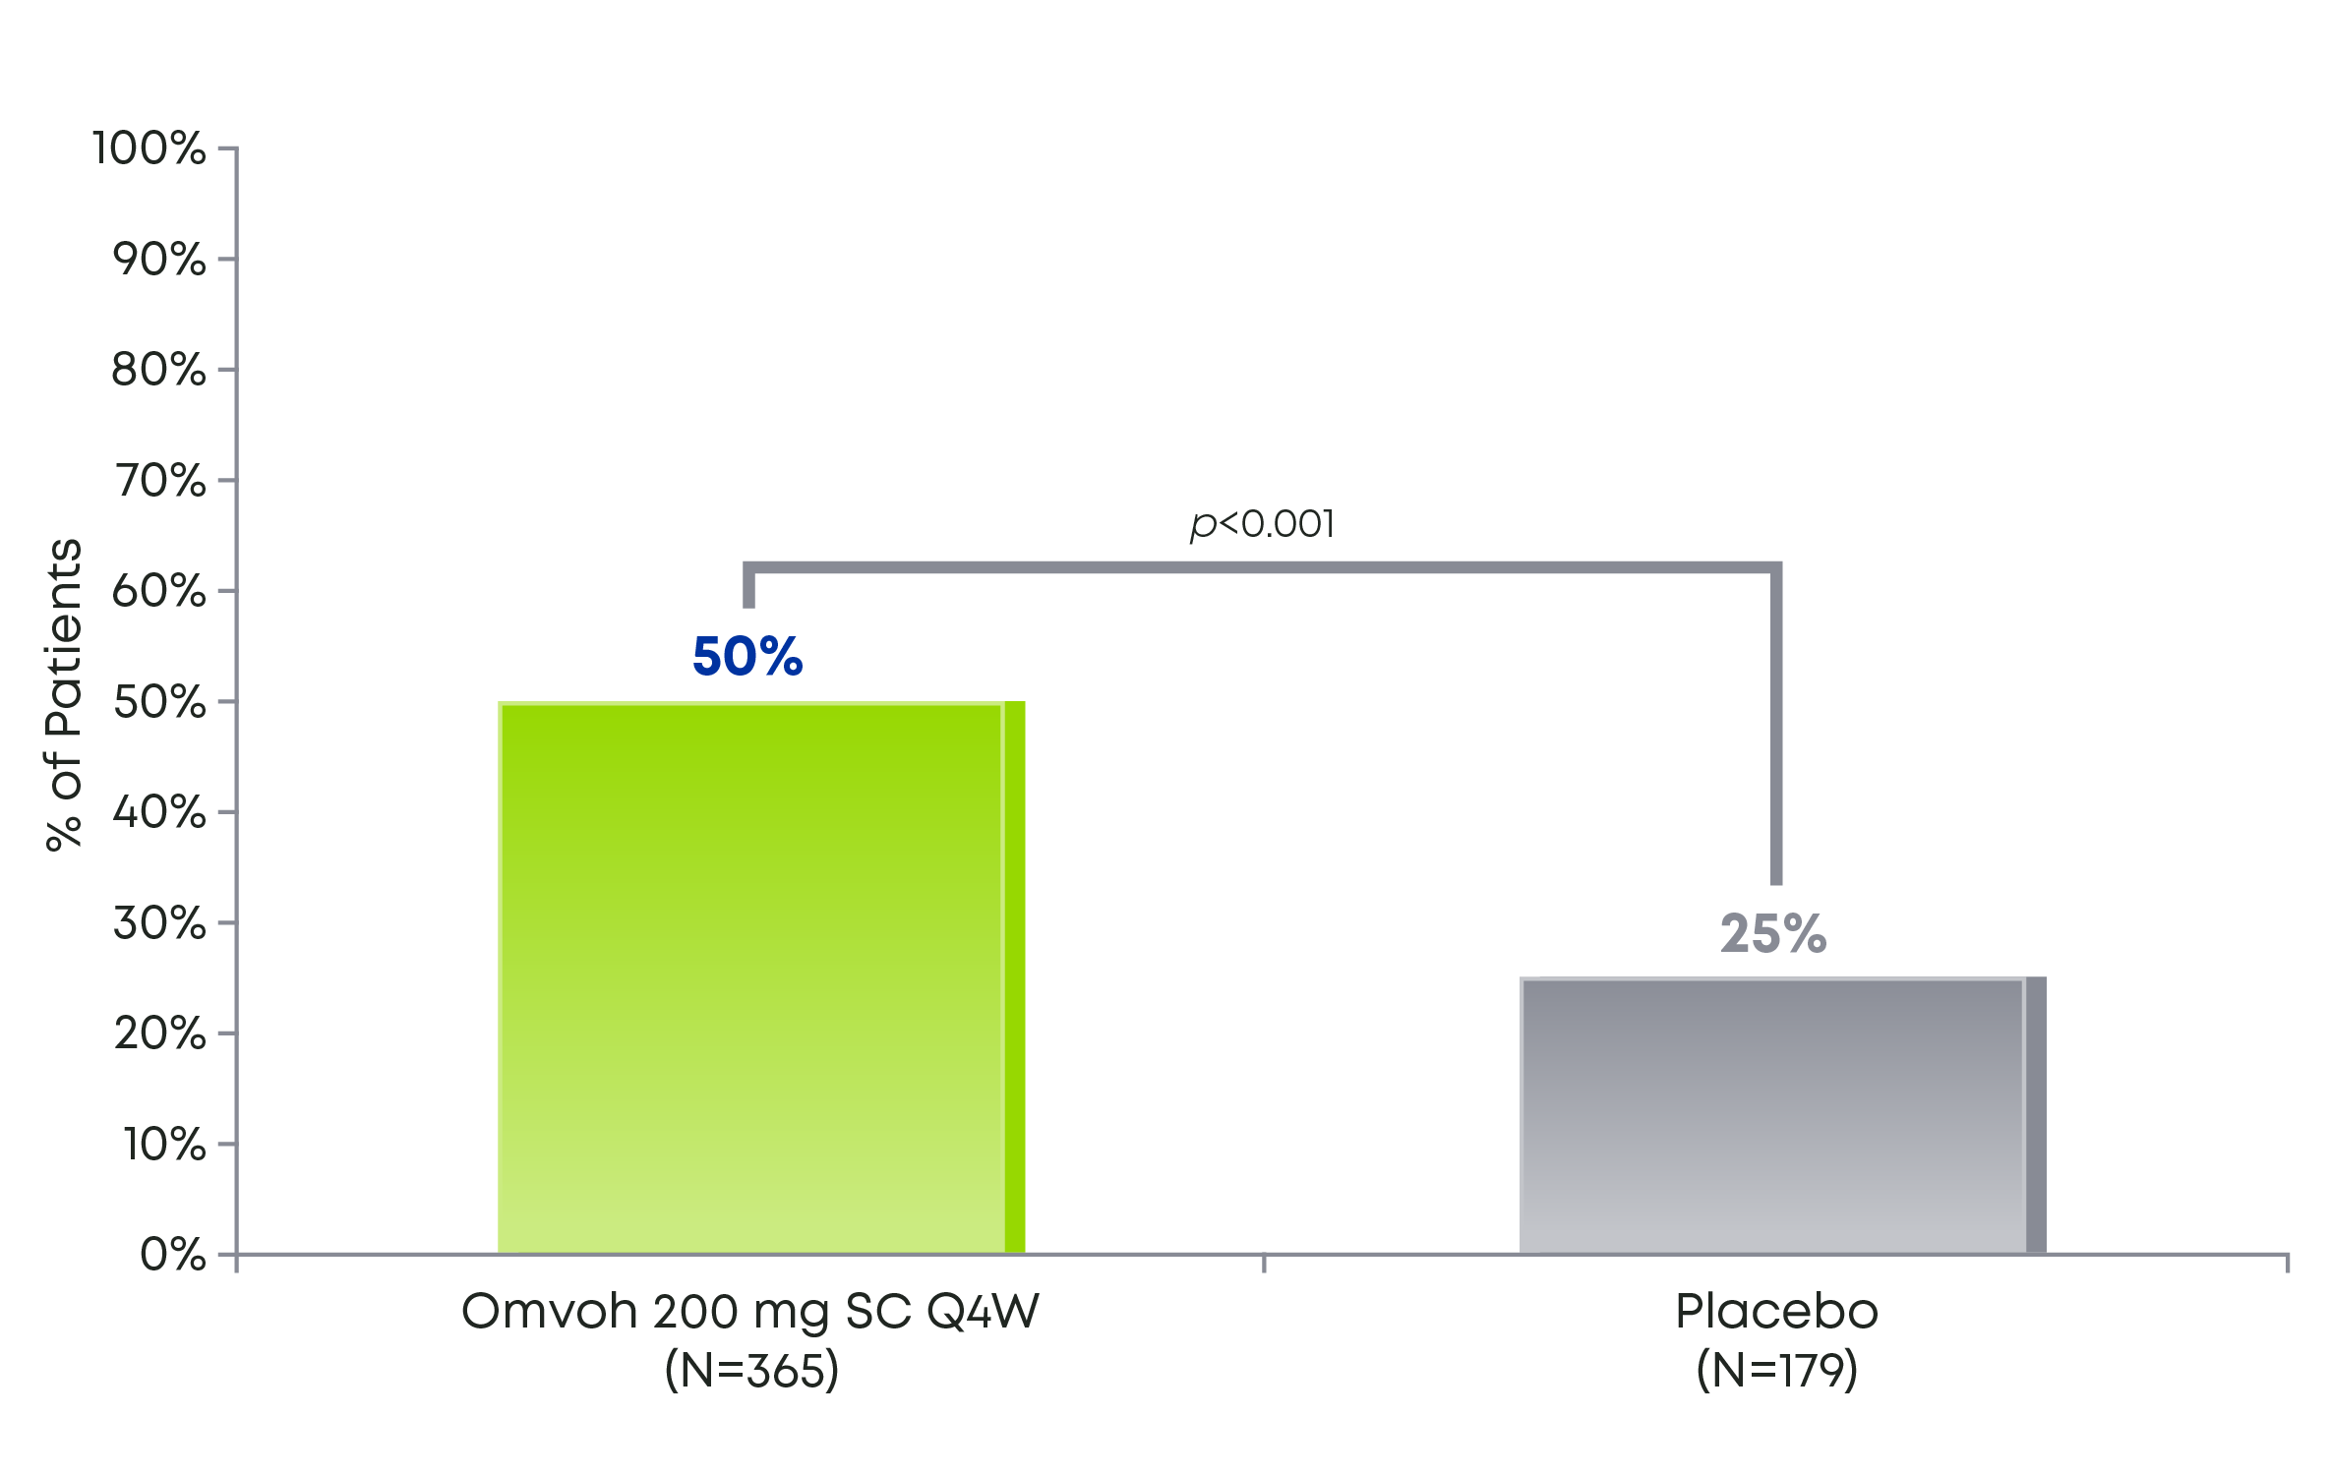

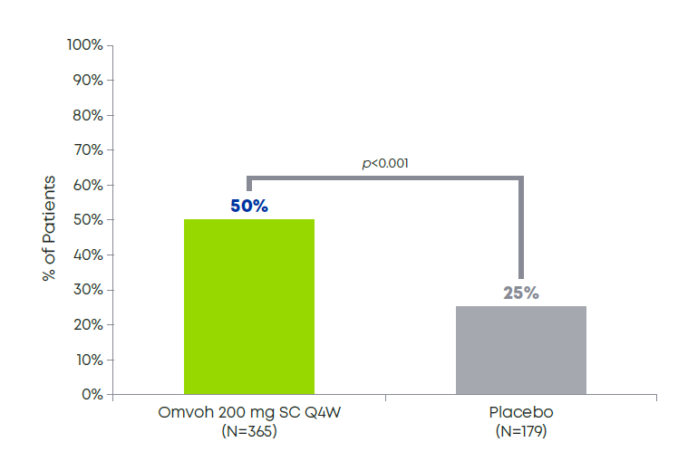
Omvoh provided sustained clinical remission at Week 52¹
MAINTENANCE STUDY
Among patients who achieved clinical response with Omvoh in LUCENT-1
Patients Achieving Clinical Remissionª at Week 52¹
98% of patients who achieved clinical remission after 1 year of treatment with Omvoh were steroid-free for at least the previous 12 weeks (n=178/182).²*
See study design on slide 19.
*The data presented are from a post hoc analysis.
ªClinical remission was defined as SF=0 or 1 with a ≥1-point decrease from baseline, and RB=0, and ES=0 or 1 (excluding friability).¹
ES=endoscopic subscore; Q4W=every 4 weeks; RB=rectal bleeding subscore; SC=subcutaneous; SF=stool frequency subscore.
Notes:
Speaker Notes:
The primary endpoint was clinical remission at Week 52 (Week 40 of LUCENT-2)¹
Of the patients who achieved clinical response in LUCENT-1, 50% achieved clinical remission after 1 year of treatment with Omvoh compared to 25% of patients who were re-randomized to placebo¹
In a post hoc analysis, 98% (n=178/182) of patients on Omvoh who achieved clinical remission after 1 year of treatment were steroid free for at least the previous 12 weeks²
References:
Omvoh Summary of Product Characteristics, Eli Lilly Nederland B.V., Utrecht, The Netherlands; 2023.
DOF TK

Slide 36
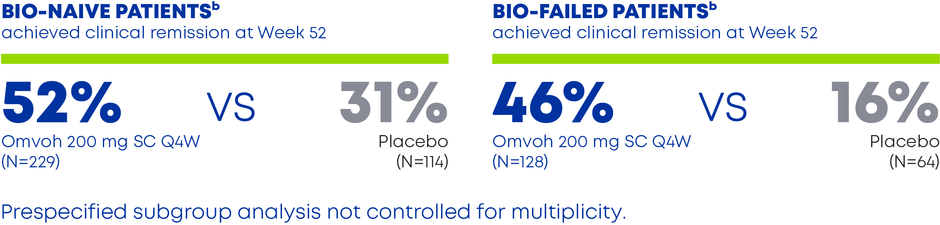
Omvoh provided clinical remission at Week 52, even in bio-failed patients¹
MAINTENANCE STUDY
Among patients who achieved clinical response with Omvoh in LUCENT-1
Clinical Remissionª in Bio-naive and Bio-failed Patients¹
Prespecified subgroup analysis not controlled for multiplicity.
Δ21%
Δ30%
See study design on slide 19.
ªClinical remission was defined as SF=0 or 1 with a ≥1-point decrease from baseline, and RB=0, and ES=0 or 1 (excluding friability).^{1 b}Bio-failed includes biologic-failed and tofacitinib-failed patients. An additional 1 patient on placebo and 8 patients on Omvoh were previously exposed to but did not fail a biologic or JAKi. These patients were excluded from the bio-naive/bio-failed subgroup analysis.¹
Bio-failed=biologic-failed; bio-naive=biologic-naive; JAKi=Janus kinase inhibitor; Q4W=every 4 weeks; SC=subcutaneous.
Notes:
Speaker Notes:
52% of patients who were biologic- or JAKi-naive achieved clinical remission with Omvoh vs 31% with placebo, a difference of 21%¹
In the biologic- or JAKi-failed subgroup, nearly half (46%) of patients achieved clinical remission with Omvoh compared to 16% with placebo, a 30% difference¹
This was a prespecified subgroup analysis and was not controlled for multiplicity
Reference:
Omvoh Summary of Product Characteristics, Eli Lilly Nederland B.V., Utrecht, The Netherlands; 2023.

Slide 37
Primärer Endpunkt: Klinische Remission in Woche 52 Erhaltungsphase, mITT-Population – MIRI-Induktions-Responder, NRI (LUCENT-2)
Klinische Remission: SF = 0, oder SF = 1 mit einer Abnahme von ≥1 Punkt gegenüber Baseline; RB = 0; ES = 0 oder 1 (ohne Schleimhautvulnerabilität)
PBO s.c.
MIRI 200 mg s.c.
p<0,001
p<0,001
49,9
46,1
Ansprechrate (95 %-KI)
Ansprechrate (95 %-KI)
25,1
15,6
N
179
365
64
128
INT-LI-AT-0001
ªEinschließlich Patienten mit Tofacitinib-Versagen. Einige wenige Patienten mit Biologika- oder Tofacitinib-Exposition, aber ohne formales Therapieversagen. ES=Endoskopischer Subscore; RB=Subscore für rektale Blutungen; SF=Subscore für die Stuhlfrequenz. Dubinsky M et al. Oral Presentation at Digestive Disease Week 2022. Data on File bei Eli Lilly and Company.
Notes:
Abbreviation(s):
CI=Confidence Interval; SC = Subcutaneous; MIRI=Mirikizumab; mITT=Modified Intent-to-Treat; NRI=Nonresponder Imputation; PBO=Placebo.
Reference(s):
/lillyce/prd/ly3074828/i6t_mc_ambg/intrm1/output/restricted/tfl/t_a_qs_clnrmwk40_nri_ir_mitt_m.rtf
/lillyce/prd/ly3074828/i6t_mc_ambg/intrm1/output/restricted/tfl/t_a_qs_mclnrem_nri_w40_puc_mitt_i.rtf
QC completed by Nathan Morris on 12/9/2021.

Slide 38
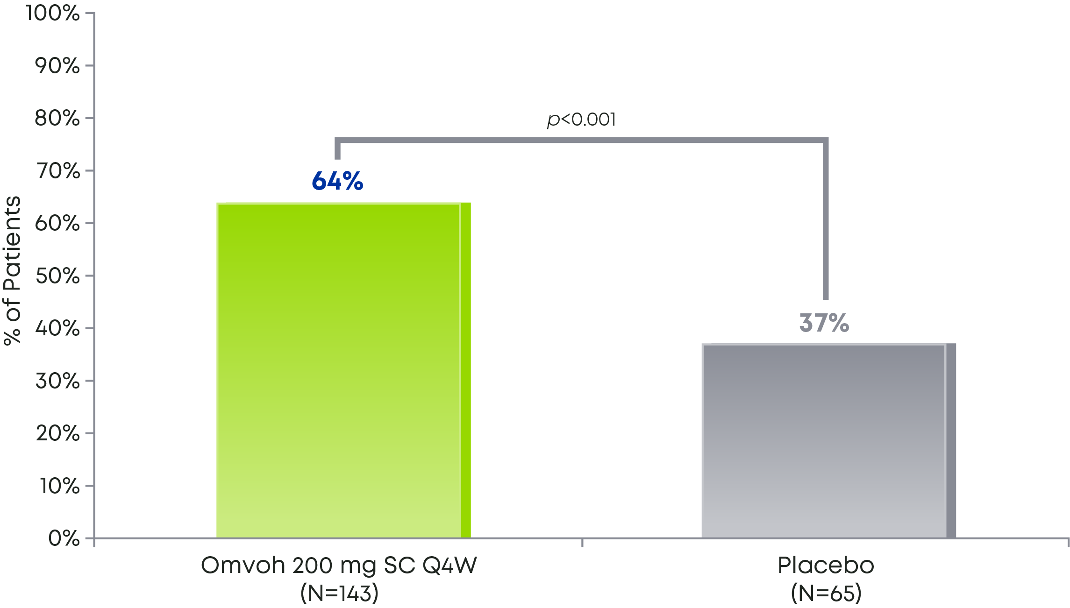
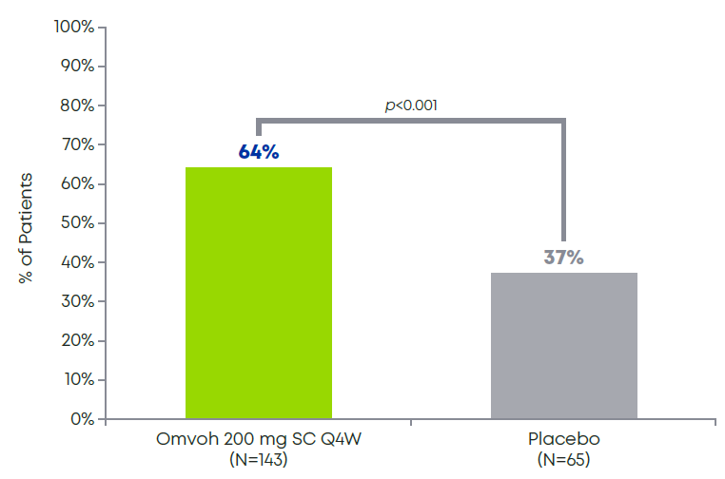
Omvoh demonstrated durable clinical remission at Week 52¹
MAINTENANCE STUDY
Among patients who achieved clinical remission with Omvoh at Week 12 in LUCENT-1
64% of patients maintained clinical remission through 1 year of continuous treatment with Omvoh¹
Maintenance of Clinical Remissionª at Week 52¹
See study design on slide 19.
ªClinical remission was defined as SF=0 or 1 with a ≥1-point decrease from baseline, and RB=0, and ES=0 or 1 (excluding friability).¹
Bio-failed=biologic-failed; bio-naive=biologic-naive; ES=endoscopic subscore; Q4W=every 4 weeks; RB=rectal bleeding subscore; SC=subcutaneous; SF=stool frequency subscore.
Notes:
Speaker Notes:
64% of patients who achieved clinical remission in the induction study maintained clinical remission through 1 year of continuous treatment with Omvoh vs 37% of the patients who were re-randomized to placebo¹
Clinical remission at Week 52 was defined based on the patients’ MMS¹
Reference:
Omvoh Summary of Product Characteristics, Eli Lilly Nederland B.V., Utrecht, The Netherlands; 2023.

Slide 39
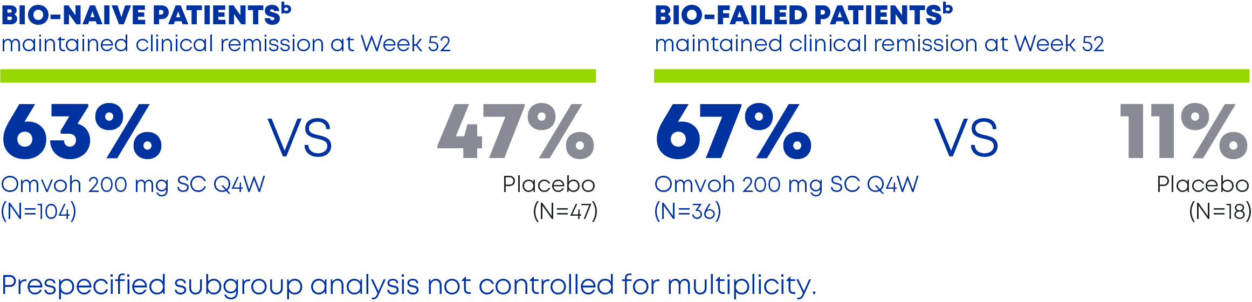

Regardless of prior biologic exposure, Omvoh demonstrated durable clinical remission in nearly two-thirds of patients¹
Among patients who achieved clinical remission with Omvoh at Week 12 in LUCENT-1
Bio-naive and Bio-failed Patients Maintained Clinical Remission^{1a}
See Results in Bio-naive and Bio-failed Patients
See study design on slide 19.
ªClinical remission was defined as SF=0 or 1 with a ≥1-point decrease from baseline, and RB=0, and ES=0 or 1 (excluding friability).¹
^{b}Bio-failed includes biologic-failed and tofacitinib-failed patients. An additional 1 patient on placebo and 8 patients on Omvoh were previously exposed to but did not fail a biologic or JAKi. These patients were excluded from the bio-naive/bio-failed subgroup analysis.¹ Bio-failed=biologic-failed; bio-naive=biologic-naive; ES=endoscopic subscore; JAKi=Janus kinase inhibitor; Q4W=every 4 weeks; RB=rectal bleeding subscore; SC=subcutaneous; SF=stool frequency subscore; TNF=tumor necrosis factor.
Notes:
Speaker Notes:
63% of patients who were biologic- or JAKi-naive maintained clinical remission from Week 12 to Week 52 with Omvoh compared to 47% with placebo¹
In the biologic- or JAKi-failed subgroup, 67% of patients maintained clinical remission from Week 12 to Week 52 with Omvoh compared to 11% with placebo¹
This was a prespecified subgroup analysis and was not controlled for multiplicity
Reference:
Omvoh Summary of Product Characteristics, Eli Lilly Nederland B.V., Utrecht, The Netherlands; 2023.

Slide 40
Clinical Remission at Week 40 in Patients in Clinical Remission at Week 12 of LUCENT-1 Maintenance Period, mITT Population – MIRI Induction Responders, NRI (LUCENT-2)
All Patients
Biologic-Naïve
Biologic-Failed
Clinical Remission: SF = 0, or SF = 1 with a ≥1 point decrease from baseline; RB = 0; ES = 0 or 1 (excluding friability)
PBO SC
MIRI 200 SC
p<0.001
p=.078
p<0.001
66.7
63.6
62.5
46.8
Response Rate (95% CI)
36.9
Response Rate (95%CI)
11.1
N
65
143
47
104
18
36
ªIncluding tofacitinib-failed patients. There are also a small group of patients exposed, by not failed to biologics or tofacitinib. Note: p-values versus PBO are shown. ES=Endoscopic Subscore; RB=Rectal Bleeding Subscore; SF=Stool Frequency Subscore. Note: Subgroup analyses by biologic-failed status in the right panel were not multiplicity controlled. Data on File, Eli Lilly and Company.
Notes:
Abbreviation(s):
CI=Confidence Interval; SC = Subcutaneous; MIRI=Mirikizumab; mITT=Modified Intent-to-Treat; NRI=Nonresponder Imputation; PBO=Placebo.
Reference(s):
/lillyce/prd/ly3074828/i6t_mc_ambg/intrm1/output/restricted/tfl/t_a_qs_clnrm_wk40_nri_icr_mit_m.rtf
/lillyce/prd/ly3074828/i6t_mc_ambg/intrm1/output/restricted/tfl/t_a_qs_clnrm_w40_sbpuc_mit_icr_m.rtf
QC completed by Nathan Morris on 12/9/2021.

Slide 41

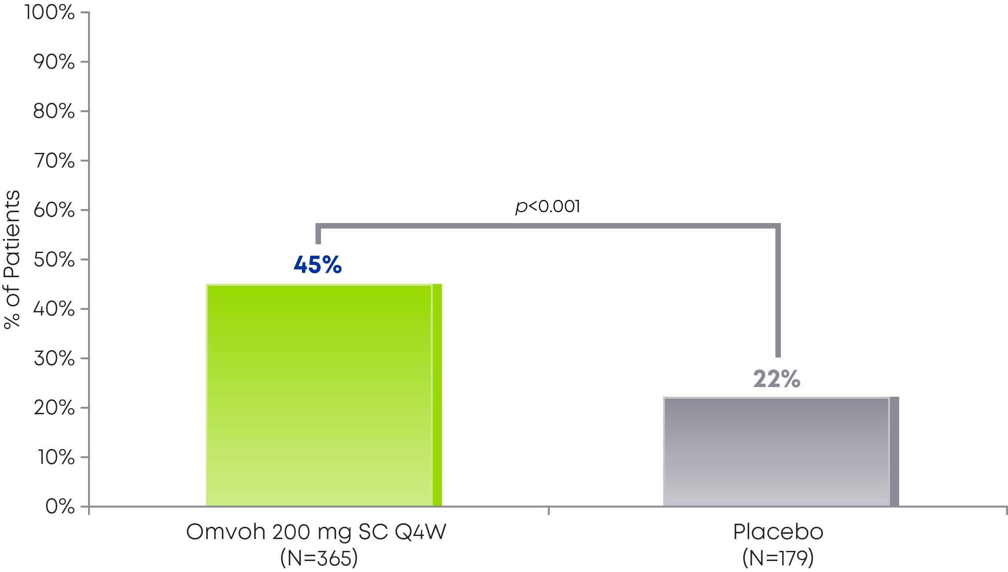
45% of patients were in corticosteroid-free remission at Week 52¹
Among patients who achieved clinical response with Omvoh in LUCENT-1
Patients Achieving Corticosteroid-Free Remissionª at Week 52¹
See study design on slide 19.
aCorticosteroid-free clinical remission without surgery was defined as clinical remission at Week 40 in LUCENT-2; symptomatic remission at Week 28; no corticosteroid use for ≥12 weeks prior to Week 40. Denominator includes all patients irrespective of baseline corticosteroid use status.1
Q4W=every 4 weeks; SC=subcutaneous.
Notes:
Speaker Notes:
Of the patients who achieved clinical response in LUCENT-1, 45% achieved corticosteroid-free remission at Week 52 with Omvoh compared with 22% taking placebo¹
Corticosteroid-free remission without surgery was defined as clinical remission at Week 40 in LUCENT-2, plus symptomatic remission at Week 28, and no corticosteroid use for at least 12 weeks prior to the Week 40 assessment¹
Reference:
Omvoh Summary of Product Characteristics, Eli Lilly Nederland B.V., Utrecht, The Netherlands; 2023.

Slide 42
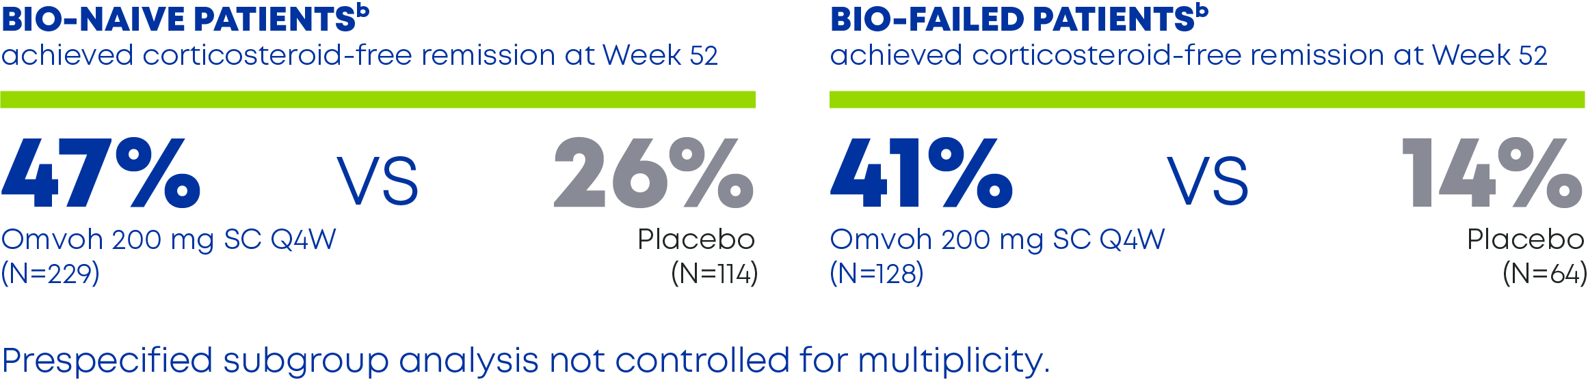
Omvoh delivered corticosteroid-free remission in bio-naive and bio-failed patients¹
Among patients who achieved clinical response with Omvoh in LUCENT-1
Corticosteroid-Free Remissionª in Bio-naive and Bio-failed Patients¹
See study design on slide 19.
ªCorticosteroid-free remission without surgery was defined as clinical remission at Week 40 in LUCENT-2; symptomatic remission at Week 28; no corticosteroid use for ≥12 weeks prior to Week 40. Denominator includes all patients irrespective of baseline corticosteroid use status.¹
^{b}Bio-failed includes biologic-failed and tofacitinib-failed patients. An additional 1 patient on placebo and 8 patients on Omvoh were previously exposed to but did not fail a biologic or JAKi. These patients were excluded from the bio-naive/bio-failed subgroup analysis.¹
Bio-failed=biologic-failed; bio-naive=biologic-naive; JAKi=Janus kinase inhibitor; Q4W=every 4 weeks; SC=subcutaneous.
Notes:
Speaker Notes:
47% of patients who were biologic- or JAKi-naive achieved corticosteroid-free remission with Omvoh compared to 26% with placebo¹
In the biologic- or JAKi-failed subgroup, 41% of patients achieved corticosteroid-free remission with Omvoh compared to 14% with placebo¹
This was a prespecified subgroup analysis and was not controlled for multiplicity
Reference:
Omvoh Summary of Product Characteristics, Eli Lilly Nederland B.V., Utrecht, The Netherlands; 2023.

Slide 43
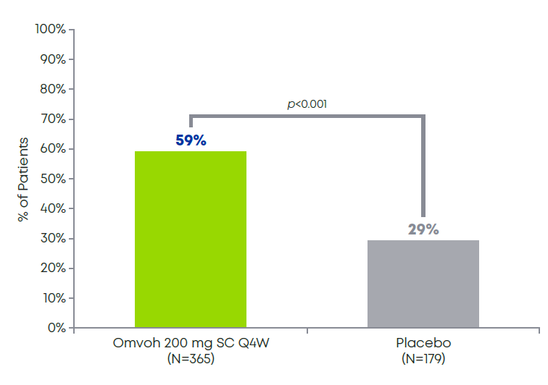
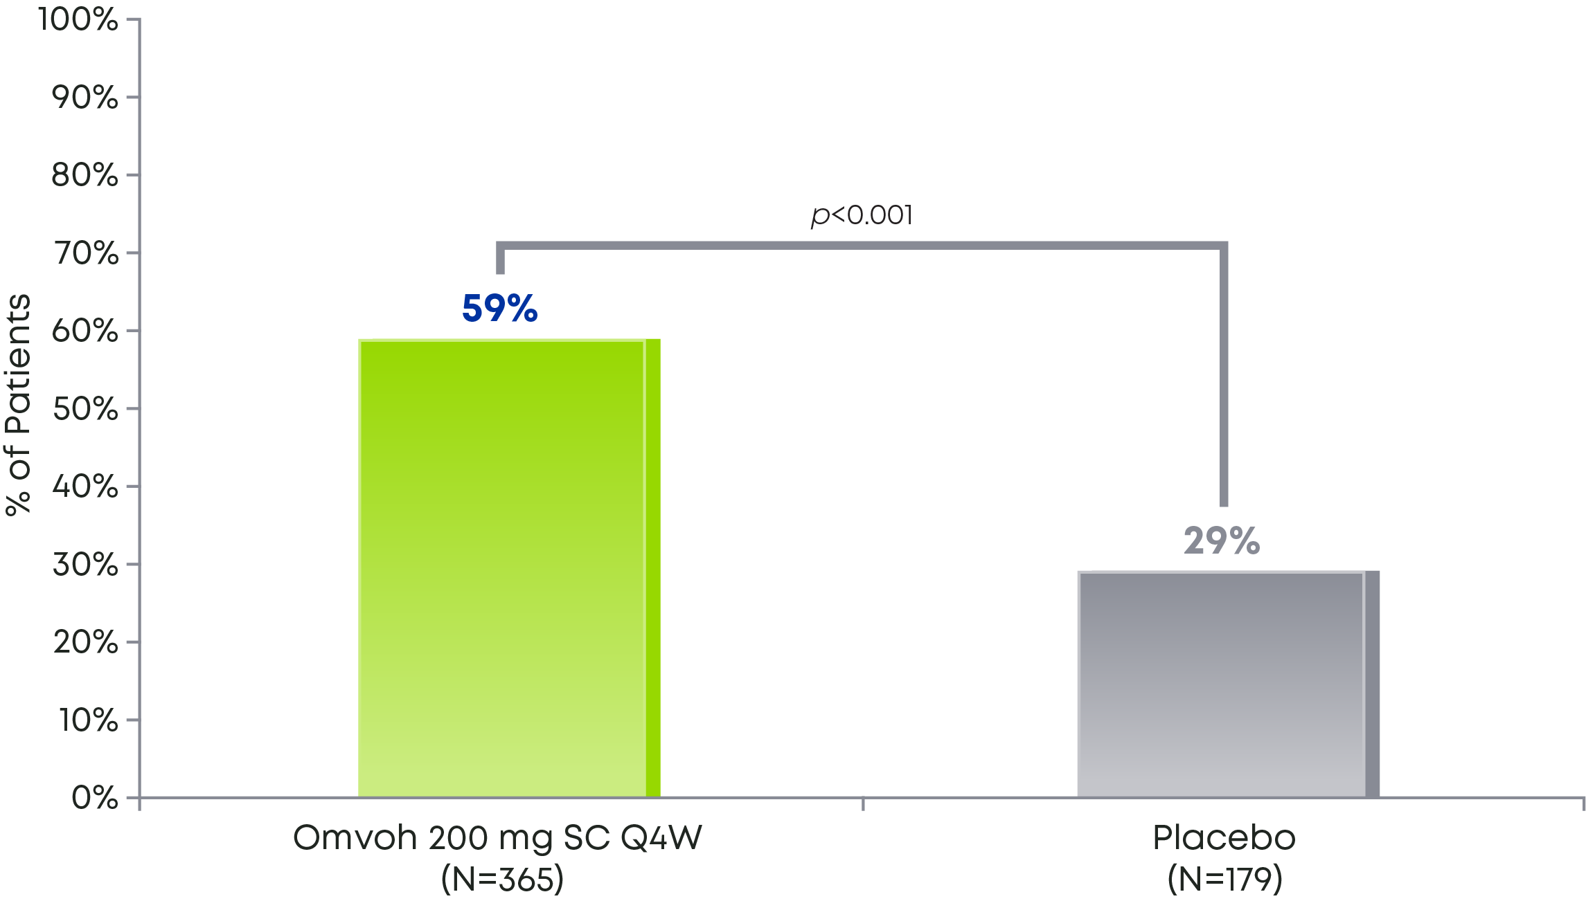
Nearly 60% of patients taking Omvoh achieved endoscopic improvement at Week 52¹
MAINTENANCE STUDY
Among patients who achieved clinical response with Omvoh in LUCENT-1
Patients Achieving Endoscopic Improvementª at Week 52¹
See study design on slide 19.
Week 52 is defined as the 12-week induction study (LUCENT-1) plus the 40-week maintenance study (LUCENT-2) for 52 weeks of continuous treatment.¹ ªEndoscopic improvement was defined as ES=0 or 1 (excluding friability).¹
ES=endoscopic subscore; Q4W=every 4 weeks; SC=subcutaneous.
Notes:
Speaker Notes:
From the responders in LUCENT-1, nearly 60% of patients taking Omvoh achieved endoscopic improvement at Week 52¹
Endoscopic improvement was defined as an endoscopic subscore of 0 or 1, excluding friability¹
Reference:
Omvoh Summary of Product Characteristics, Eli Lilly Nederland B.V., Utrecht, The Netherlands; 2023.

Slide 44
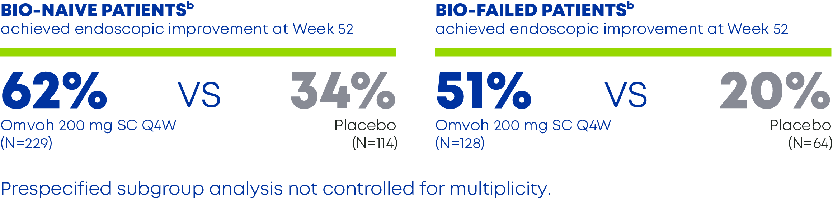
At least half of bio-naive and bio-failed patients achieved endoscopic improvement at Week 52¹
Among patients who achieved clinical response with Omvoh in LUCENT-1
Endoscopic Improvementª in Bio-naive and Bio-failed Patients¹
See study design on slide 19.
ªEndoscopic improvement was defined as ES=0 or 1 (excluding friability).¹
^{b}Bio-failed includes biologic-failed and tofacitinib-failed patients. An additional 1 patient on placebo and 8 patients on Omvoh were previously exposed to but did not fail a biologic or JAKi. These patients were excluded from the bio-naive/bio-failed subgroup analysis.¹
Bio-failed=biologic-failed; bio-naive=biologic-naive; ES=endoscopic subscore; JAKi=Janus kinase inhibitor; Q4W=every 4 weeks; SC=subcutaneous.
Notes:
Speaker Notes:
62% of patients who were biologic- or JAKi-naive achieved endoscopic improvement with Omvoh compared to 34% with placebo¹
In the biologic- or JAKi-failed subgroup, more than half of patients (51%) achieved endoscopic improvement with Omvoh compared to 20% with placebo¹
This was a prespecified subgroup analysis and was not controlled for multiplicity
Reference:
Omvoh Summary of Product Characteristics, Eli Lilly Nederland B.V., Utrecht, The Netherlands; 2023.

Slide 45
Endoscopic Improvement at Week 52 Maintenance Period, mITT Population – MIRI Induction Responders, NRI (LUCENT-2)
Endoscopic Remission: ES = 0 or 1 (excluding friability)
PBO SC
MIRI 200 SC
p<0.001
p<0.001
p<0.001
62.4
58.6
50.8
Response Rate (95% CI)
Response Rate (95%CI)
34.2
29.1
20.3
N
179
365
114
229
64
128
aIncluding tofacitinib-failed patients. There are also a small group of patients exposed, by not failed to biologics or tofacitinib. Note: p-values versus PBO are shown. ES=Endoscopic Subscore. Note: Subgroup analyses by biologic-failed status in the right panel were not multiplicity controlled. Data on File, Eli Lilly and Company.
Notes:
Abbreviation(s):
CI=Confidence Interval; SC = Subcutaneous; MIRI=Mirikizumab; mITT=Modified Intent-to-Treat; NRI=Nonresponder Imputation; PBO=Placebo.
Reference(s):
/lillyce/prd/ly3074828/i6t_mc_ambg/intrm1/output/restricted/tfl/t_a_qs_endrem_wk40_nri_ir_m_ma.rtf
/lillyce/prd/ly3074828/i6t_mc_ambg/intrm1/output/restricted/tfl/t_a_qs_menrem_nri_w40_puc_mitt_i.rtf
QC completed by Nathan Morris on 12/9/2021.

Slide 46
Endoscopic improvement with Omvoh
The following images represent an individual patient with moderately to severely active UC who was treated with Omvoh. Endoscopies were performed at baseline (Week 0), Week 12, and Week 52. Individual results may vary; examples are for educational purposes only.
Baseline (Week 0)
Week 12
Week 52
ES=3
ES=0
ES=0
At Week 52, normalization of endoscopic appearance (ES=0) was achieved in 22% of patients taking Omvoh vs 13% of patients taking placebo.²
See study design on slide 19.
ES=endoscopic subscore; UC=ulcerative colitis.
Notes:
Speaker Notes:
These are endoscopic images of one patient with moderately to severely active UC who was treated with Omvoh¹
Individual results may vary
At baseline, the endoscopic subscore was 3; at Week 12 and Week 52, the endoscopic subscore was 0¹
Normalization of the endoscopic appearance was achieved in 22% of patients taking Omvoh at Week 52 vs 13% of patients taking placebo²
References:
DOF
Omvoh Summary of Product Characteristics, Eli Lilly Nederland B.V., Utrecht, The Netherlands; 2023.

Slide 47
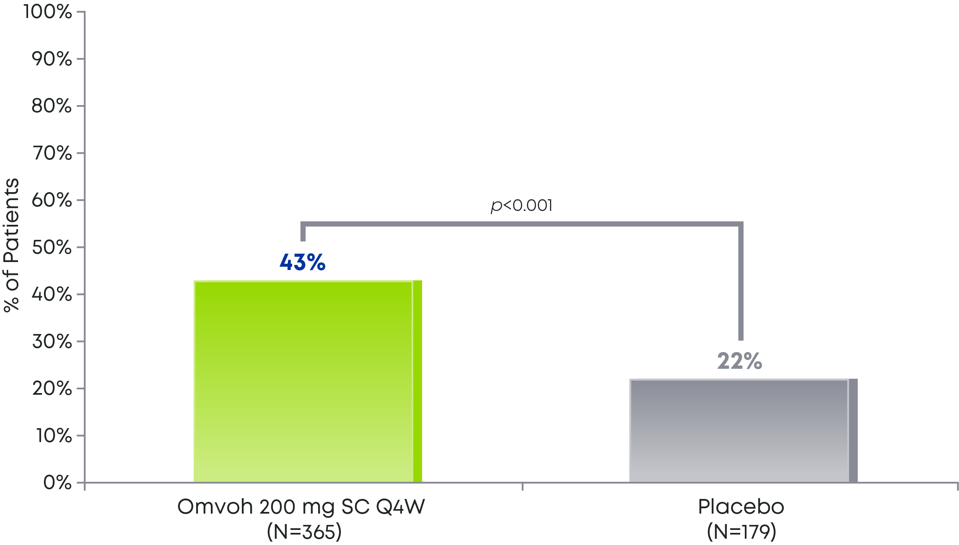
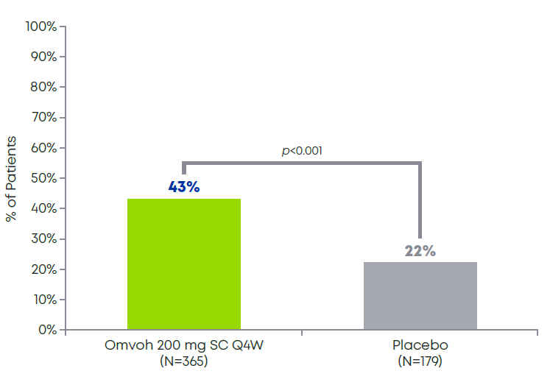
Omvoh demonstrated histo-endoscopic mucosal remission (HEMR) at Week 52¹
MAINTENANCE STUDY
Among patients who achieved clinical response with Omvoh in LUCENT-1
43% of patients achieved absence of acute cellular inflammation at Week 52 as measured by HEMR¹
Proportion of Patients Achieving HEMRª at Week 52¹
See study design on slide 19.
ªHEMR was defined as achieving both: 1. Histologic remission, defined as Geboes subscores of 0 for grades: 2b (lamina propria neutrophils), and 3 (neutrophils in epithelium), and 4 (crypt destruction), and 5 (erosion or ulceration); and 2. Mayo endoscopic score 0 or 1 (excluding friability).¹
HEMR=histo-endoscopic mucosal remission; Q4W=every 4 weeks; SC=subcutaneous.
Notes:
Speaker Notes:
43% of patients achieved absence of acute cellular inflammation at Week 52 as measured by histo-endoscopic mucosal remission (HEMR)¹
However, LUCENT-2 was not designed to evaluate the relationship between HEMR at Week 52 and disease progression or long-term outcomes¹
Reference:
Omvoh Summary of Product Characteristics, Eli Lilly Nederland B.V., Utrecht, The Netherlands; 2023.

Slide 48
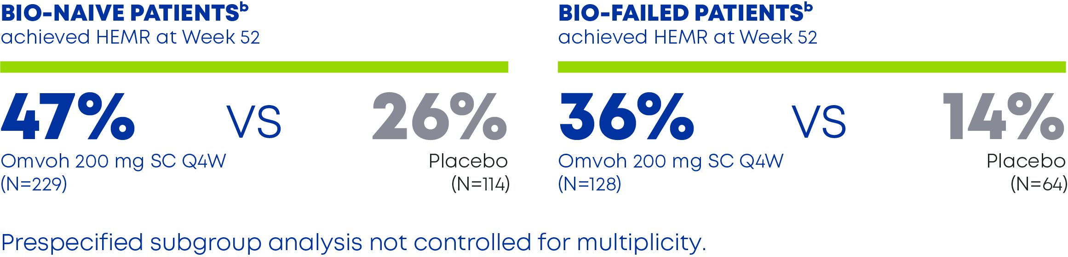
Among patients who achieved clinical response with Omvoh in LUCENT-1
Even in the bio-failed subgroup, patients on Omvoh achieved HEMR at Week 52 vs placebo¹
HEMRª in Bio-naive and Bio-failed Patients¹
See study design on slide 19.
ªHEMR, defined as achieving both: 1. Histologic remission, defined as Geboes subscores of 0 for graces: 2b (lamina propria neutrophils), and 3 (neutrophils in epithelium), and 4 (crypt destruction), and 5 (erosion or ulceration) and 2. Mayo endoscopic score 0 or 1 (excluding friability).¹
^{b}Bio-failed includes biologic-failed and tofacitinib-failed patients. An additional 1 patient on placebo and 8 patients on Omvoh were previously exposed to but did not fail a biologic or JAKi. These patients were excluded from the bio-naive/bio-failed subgroup analysis.¹
Bio-failed=biologic-failed; bio-naive=biologic-naive; JAKi=Janus kinase inhibitor; HEMR=histo-endoscopic mucosal remission; Q4W=every 4 weeks; SC=subcutaneous.
Notes:
Speaker Notes:
47% of patients who were biologic- or JAKi-naive achieved HEMR with Omvoh compared to 26% with placebo¹
In the biologic- or JAKi-failed subgroup, 36% of patients achieved HEMR with Omvoh compared to 14% with placebo¹
This was a prespecified subgroup analysis and was not controlled for multiplicity
Reference:
Omvoh Summary of Product Characteristics, Eli Lilly Nederland B.V., Utrecht, The Netherlands; 2023.

Slide 49
Histologic-Endoscopic Mucosal Remission at Week 52 Maintenance Period, mITT Population – MIRI Induction Responders, NRI (LUCENT-2)
Histologic-Endoscopic Mucosal Remission : Histologic remission with resolution of neutrophils, defined using Geboes scoring systemª; ES = 0 or 1 (excluding friability)
PBO SC
MIRI 200 SC
p<0.001
p<0.001
p=.001
43.3
47.2
Response Rate (95% CI)
Response Rate (95%CI)
35.9
21.8
26.3
14.1
N
179
365
114
229
64
128
ªGeboes subscores of 0 for grades: 2b (lamina propria neutrophils); 3 (neutrophils in epithelium); 4 (crypt destruction); 5 (erosion or ulceration). ^{b}Including tofacitinib-failed patients. There are also a small group of patients exposed, by not failed to biologics or tofacitinib. Note: p-values versus PBO are shown. ES=Endoscopic Subscore. Note: Subgroup analyses by biologic-failed status in the right panel were not multiplicity controlled. Data on File, Eli Lilly and Company.
Notes:
Abbreviation(s):
CI=Confidence Interval; SC = Subcutaneous; MIRI=Mirikizumab; mITT=Modified Intent-to-Treat; NRI=Nonresponder Imputation; PBO=Placebo.
Reference(s):
/lillyce/prd/ly3074828/i6t_mc_ambg/intrm1/output/restricted/tfl/t_a_qs_histrem_wk40_nri_ir_m_ma.rtf
/lillyce/prd/ly3074828/i6t_mc_ambg/intrm1/output/restricted/tfl/t_a_qs_hemr_nri_w40_puc_mit_ir_m.rtf
QC completed by Nathan Morris on 12/9/2021.

Slide 50

How did the Omvoh clinical trials measure bowel urgency?¹
The urgency numeric rating SCALE (UNRS)^{1,2}
0 | 1 | 2 | 3 | 4 | 5 | 6 | 7 | 8 | 9 | 10
Bowel urgency is defined as the sudden or immediate need to have a bowel movement²
Bowel urgency was assessed on the 11-point UNRS in LUCENT-1 and LUCENT-2¹
Patients reported the severity of urgency to have a bowel movement ranging from 0 (no urgency) to 10 (worst possible urgency) over the past 24 hours²
Reported scores are the average of patients’ scores over a week²
The UNRS is a reliable and valid measure in adult patients with UC²
No urgency
Worst possible urgency
averaged
over the past
7 days
UC=ulcerative colitis; UNRS=Urgency Numeric Rating Scale.
Notes:
Claim TK
Speaker Notes:
The LUCENT-1 and LUCENT-2 clinical trials included a measure of bowel urgency¹
The UNRS was developed as a patient-reported measure, and was measured as an average value over the past week²
References:
Omvoh Summary of Product Characteristics, Eli Lilly Nederland B.V., Utrecht, The Netherlands; 2023.
Dubinsky MC, Irving PM, Panaccione R, et al. Incorporating patient experience into drug development for ulcerative colitis: development of the Urgency Numeric Rating Scale, a patient-reported outcome measure to assess bowel urgency in adults. J Patient Rep Outcomes. 2022;6(1):31. doi:10.1186/s41687-022-00439-w

Slide 51
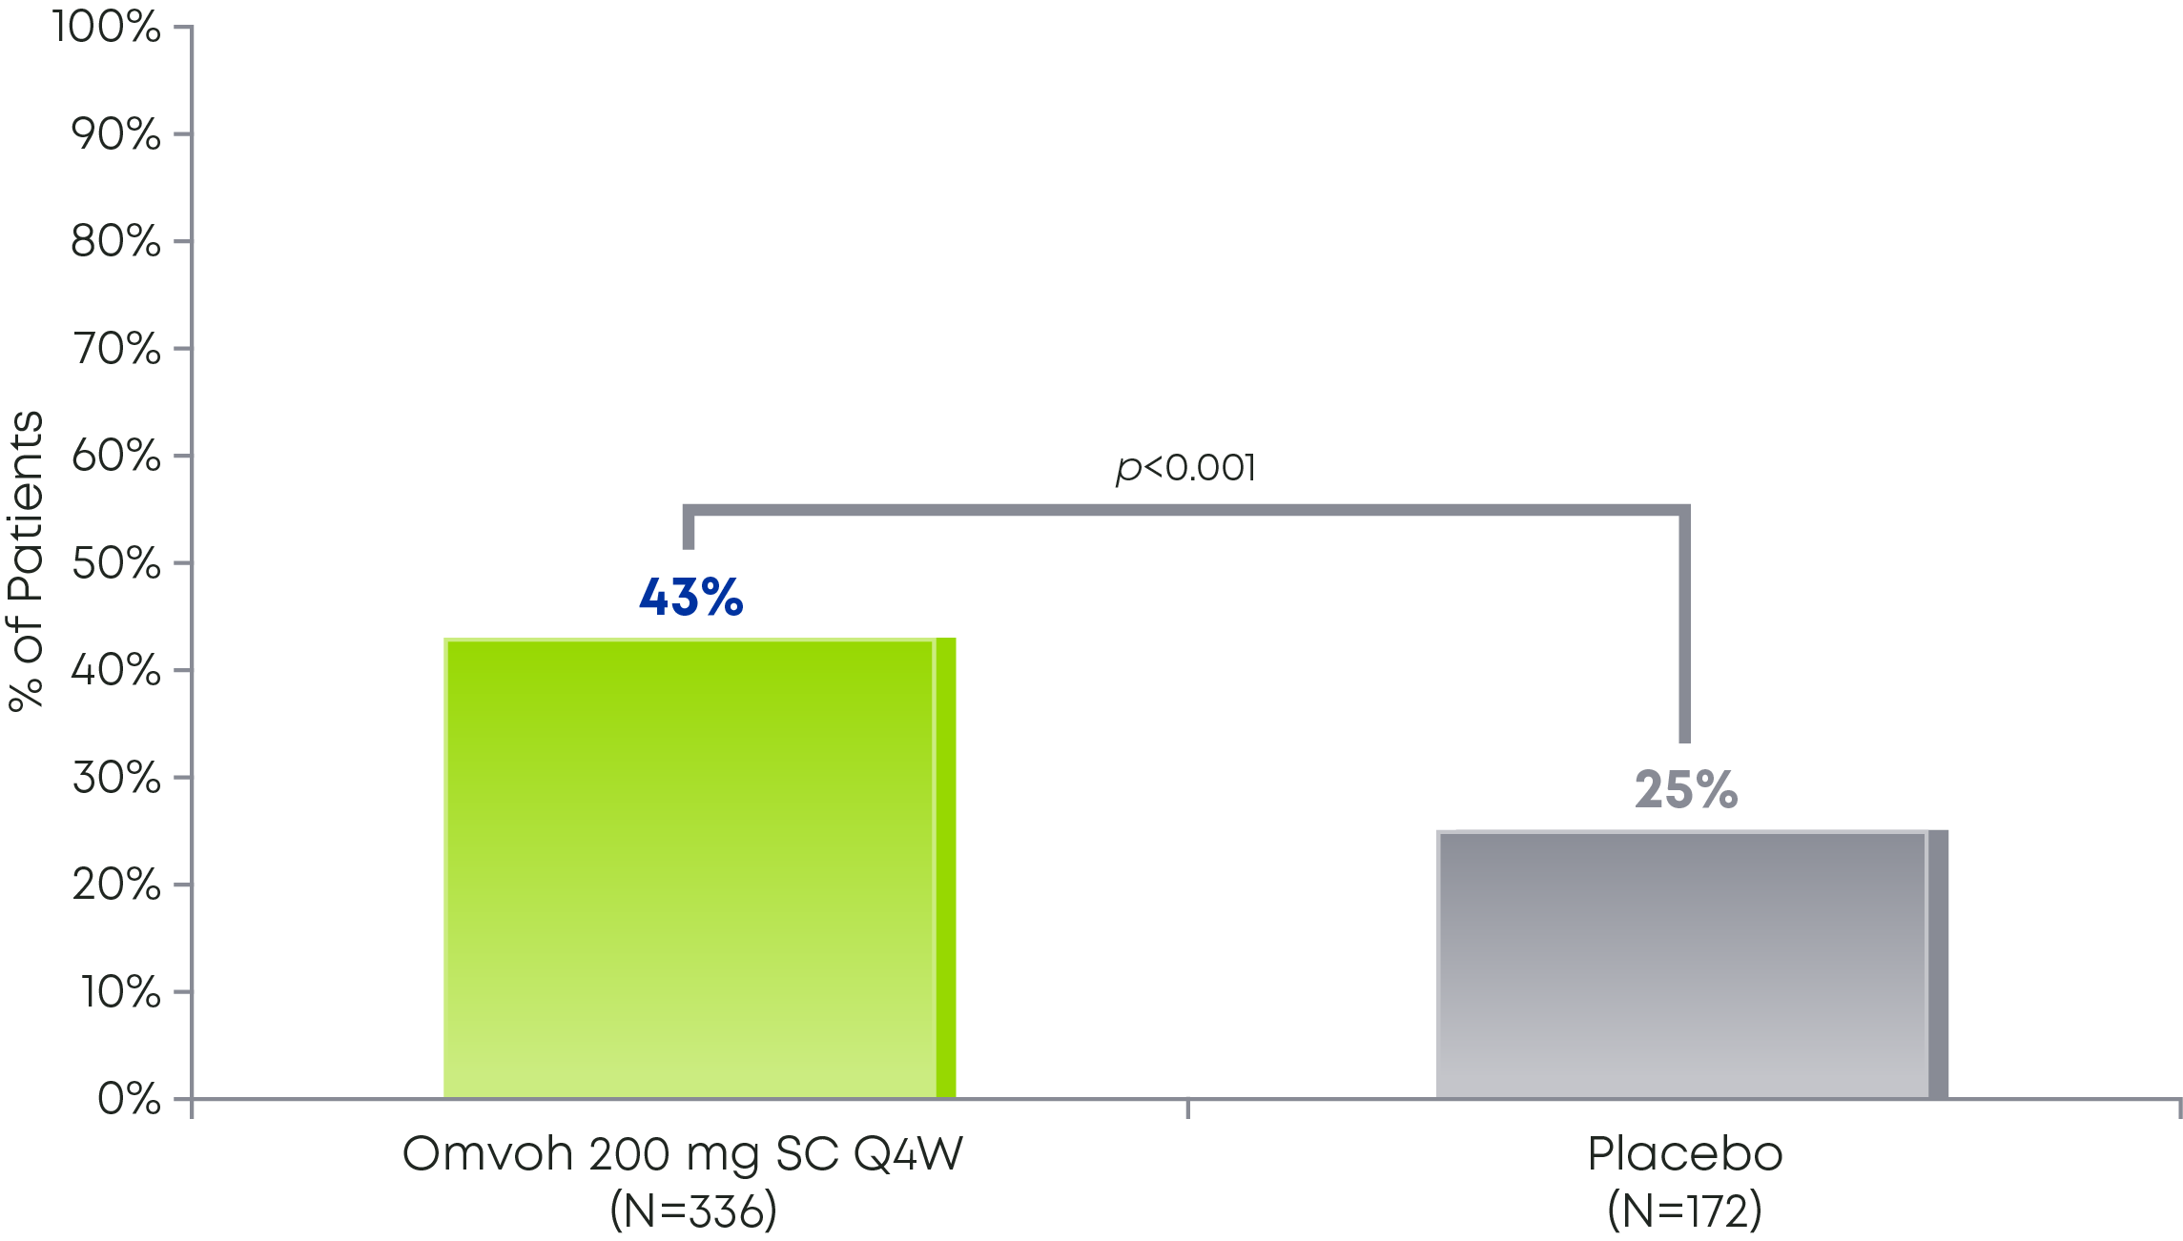
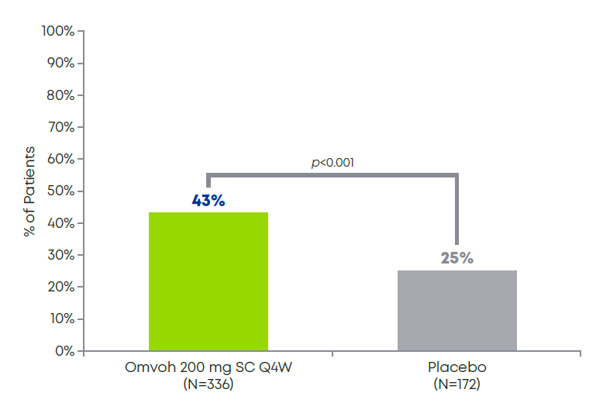
43% of patients taking Omvoh achieved bowel urgency remission at Week 52¹
MAINTENANCE STUDY
Among patients who achieved clinical response with Omvoh in LUCENT-1
among the patients who achieved clinical response in the induction study, 43% of patients* achieved bowel urgency remissionª at week 52 (UNRS=0 or 1)
Patients Achieving Bowel Urgency Remissionª at Week 52 (UNRS=0 or 1)¹
Bowel urgency was assessed by patients using the 11-point UNRS, which measured the severity of urgency to have a bowel movement ranging from 0 (no urgency) to 10 (worst possible urgency).²
See study design on slide 19.
ªBowel urgency remission: Patients rating bowel urgency severity as 0 or 1 on UNRS (0-10).^{1,2}
^{b}Patients included in this analysis had a UNRS score of ≥3 at baseline in LUCENT-1.¹
Q4W=every 4 weeks; SC=subcutaneous; UC=ulcerative colitis; UNRS=Urgency Numeric Rating Scale.
Notes:
Speaker Notes:
Bowel urgency is one patients’ most disruptive UC symptoms³
Bowel urgency was assessed by patients using the 11-point UNRS, which measured the severity of urgency to have a bowel movement ranging from 0 (no urgency) to 10 (worst possible urgency)²
This improvement happened rapidly; UNRS weekly average scores of 0 to 1 were observed in a greater proportion of patients treated with Omvoh compared to placebo at Week 12¹
References:
Omvoh Summary of Product Characteristics, Eli Lilly Nederland B.V., Utrecht, The Netherlands; 2023.
Dubinsky MC, Irving PM, Panaccione R, et al. Incorporating patient experience into drug development for ulcerative colitis: development of the Urgency Numeric Rating Scale, a patient-reported outcome measure to assess bowel urgency in adults. J Patient Rep Outcomes. 2022;6(1):31. doi:10.1186/s41687-022-00439-w
Carpio D, López-Sanromán A, Calvet X, et al. Perception of disease burden and treatment satisfaction in patients with ulcerative colitis from outpatient clinics in Spain: UC-LIFE survey. Eur J Gastroenterol Hepatol. 2016;28(9):1056-1064. doi:10.1097/MEG.0000000000000658

Slide 52
Reduced bowel urgency with Omvoh by Week 121
among the patients who achieved clinical response in the induction study, 43% of patients* achieved bowel urgency remissionª at week 52 (UNRS=0 or 1)
Change in Bowel Urgency Severity^{1,2a}
See study design on slide 19.
ªBowel urgency severity estimated by LSM change from baseline in the UNRS score (0 indicates no urgency, 10 indicates worst possible urgency).^{1,3}
IV=intravenous; LSM=least squares mean; Q4W=every 4 weeks; UNRS=Urgency Numeric Rating Scale.
Notes:
Speaker Notes:
Patients taking Omvoh began to experience improvement in bowel urgency severity as early as Week 2¹
At Week 12, there was a significant decrease in bowel urgency severity in patients taking Omvoh vs placebo¹
Bowel urgency severity was assessed by LSM change from baseline in the UNRS score (0 indicates no urgency, 10 indicates worst possible urgency)^{1,3}
References:
Omvoh Summary of Product Characteristics, Eli Lilly Nederland B.V., Utrecht, The Netherlands; 2023.
DOF?
Dubinsky MC, Irving PM, Panaccione R, et al. Incorporating patient experience into drug development for ulcerative colitis: development of the Urgency Numeric Rating Scale, a patient-reported outcome measure to assess bowel urgency in adults. J Patient Rep Outcomes. 2022;6(1):31. doi:10.1186/s41687-022-00439-w

Slide 53
Omvoh safety
Safety

Slide 54
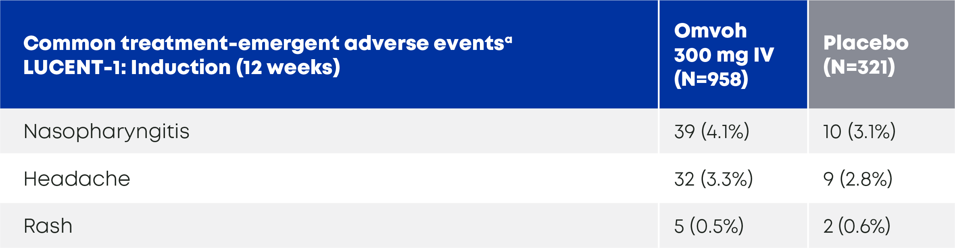
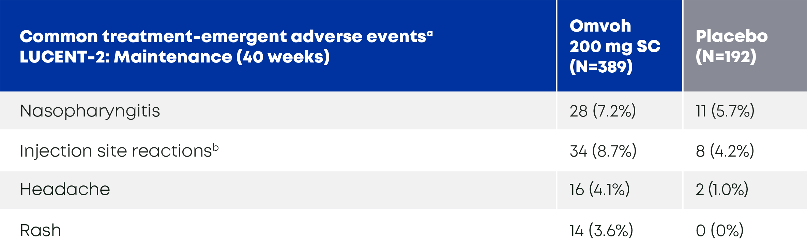
The safety of Omvoh was evaluated in two randomized, double-blind, placebo-controlled Phase 3 trials^{1,2}
Adverse Drug Reactions in LUCENT-1 (Induction, 12 weeks)²
Adverse Drug Reactions in LUCENT-2 (Maintenance, 40 weeks)^{1,2}
ªOccurring in ≥3% of patients in any treatment group during induction or maintenance; listed by decreasing frequency in the Omvoh arm during maintenance.^{2 b}The most frequent events were injection site pain, injection site reaction, and injection site erythema. These symptoms were usually reported as non-serious, mild, and transient in nature.¹ IV=intravenous; SC=subcutaneous.
Notes:
Speaker Notes:
The adverse events profile was similar between LUCENT-1 and LUCENT-2²
In LUCENT-1, infusion-related hypersensitivity reactions were reported in 0.4% of Omvoh-treated patients. All infusion-related hypersensitivity reactions were reported as non-serious¹
In LUCENT-2, injection site reactions were reported in 8.7% of Omvoh-treated patients. The most frequent reactions were injection site pain, injection site reaction and injection site erythema. These symptoms were reported as non-serious, mild, and transient in nature¹
References:
Omvoh Summary of Product Characteristics, Eli Lilly Nederland B.V., Utrecht, The Netherlands; 2023.
D’Haens G, Dubinsky M, Kobayashi T, et al. Mirikizumab as induction and maintenance therapy for ulcerative colitis. Draft Manuscript. 2023;TK:TK-TK.

Slide 55
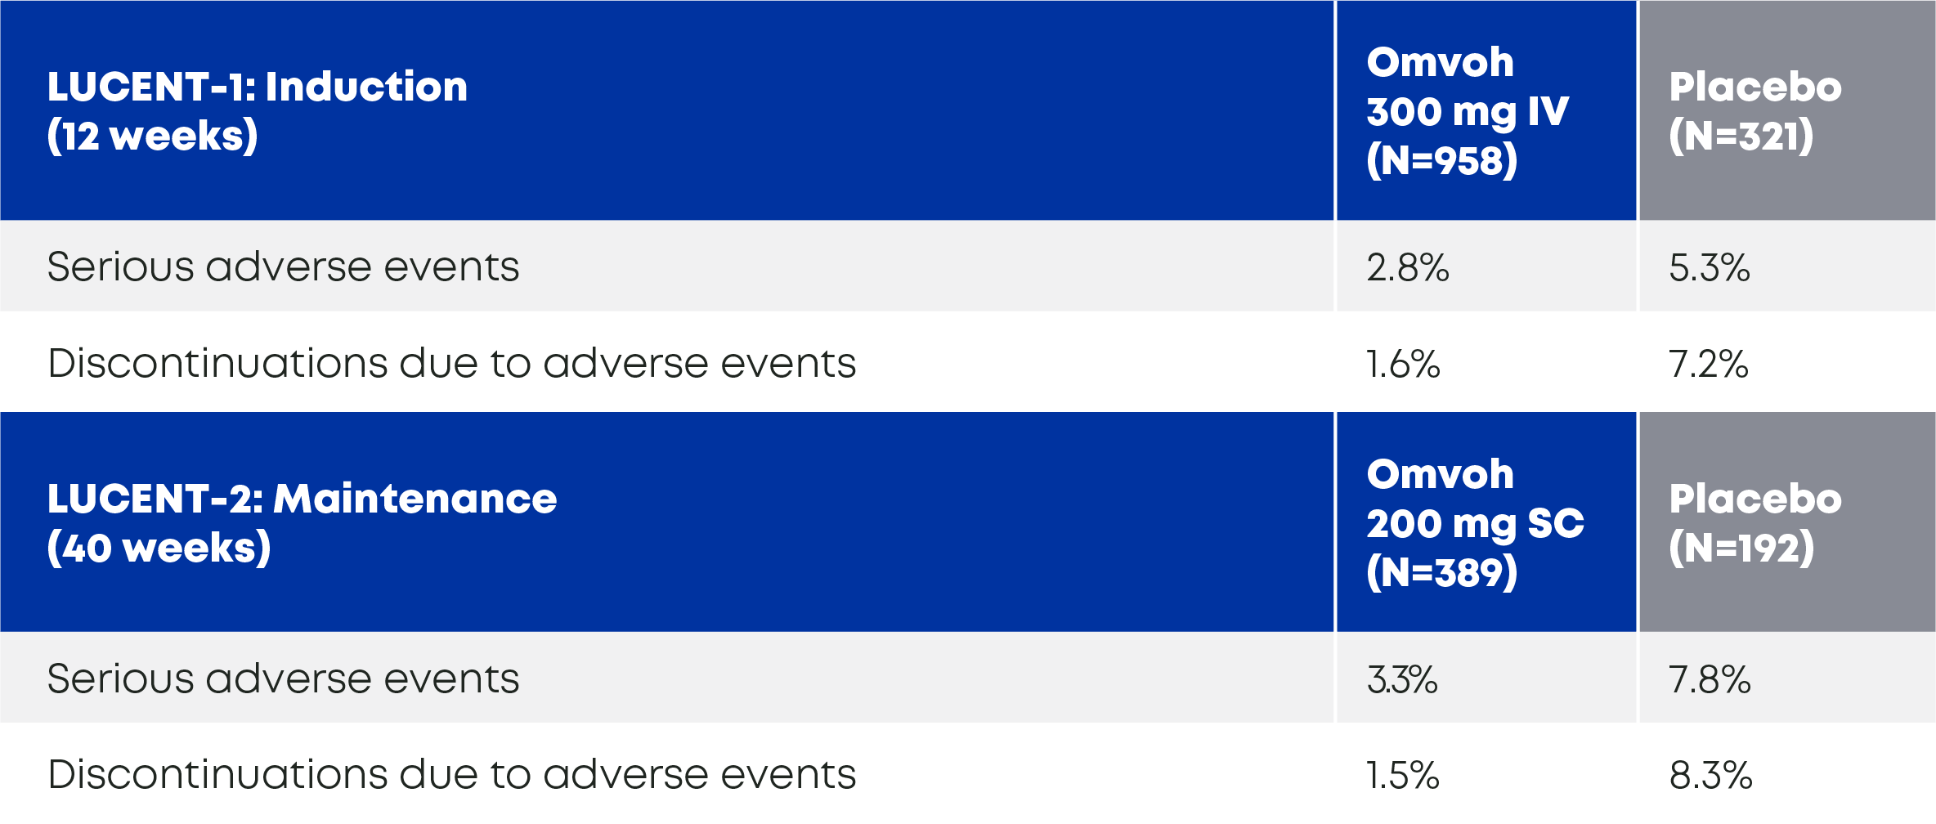
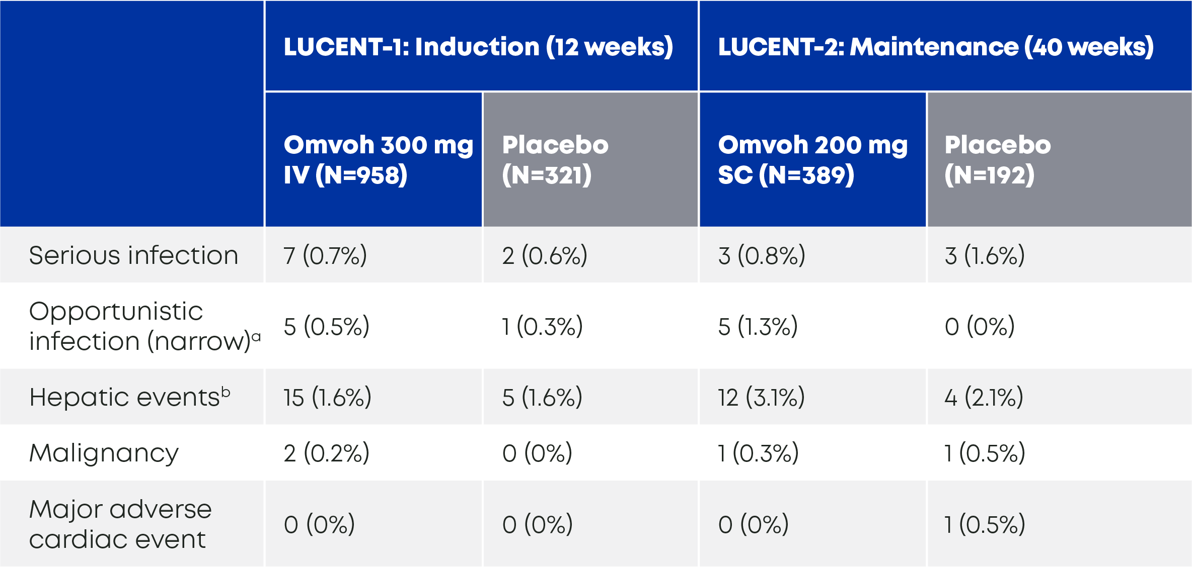
Omvoh had numerically lower frequencies of serious adverse events and discontinuations vs placebo¹
Serious Adverse Events and Discontinuation¹
Adverse Events of Special Interest¹
ªExcluding oral candidiasis and oral fungal infection.¹
^{b}Hepatic events include laboratory abnormalities reported as adverse events as well as any hepatobiliary disorder.¹ AE=adverse event; IV=intravenous; SC=subcutaneous.
Notes:
Speaker Notes:
The rate of serious adverse events and discontinuations of study treatment due to adverse events was numerically lower with Omvoh vs placebo across both trials¹
Speaker Prompt: Here you might discuss your own experience with the lack of need for ongoing lab monitoring for most patients.
Reference:
D’Haens G, Dubinsky M, Kobayashi T, et al. Mirikizumab as induction and maintenance therapy for ulcerative colitis. Draft Manuscript. 2023;TK:TK-TK.

Slide 56
Übersicht über unerwünschte Ereignisse Erhaltungsphase, Sicherheitspopulation – Mirikizumab-Induktions-Responder (LUCENT-2)
 | MIRI-Induktions-Responder
 | PBO s.c. N=192 | MIRI 200 mg s.c. N=389
Patienten mit ≥1 TEAE, n (%) | 132 (68,8%) | 251 (64,5%)
Leicht | 71 (37,0%) | 148 (38,0%)
Mäßig | 49 (25,5%) | 87 (22,4%)
Schwer | 12 (6,3%) | 16 (4,1%)
Tod, n (%) | 1 (0,5%) | 0
Schwerwiegendes unerwünschtes Ereignis, n (%) | 15 (7,8%) | 13 (3,3%)
Behandlungsabbruch aufgrund von AEª, n (%) | 16 (8,3%) | 6 (1,5%)
INT-LI-AT-0001
ªEinschließlich Tod. Dubinsky M et al. Oral Presentation at Digestive Disease Week 2022.
Data on File bei Eli Lilly and Company.
Notes:
Abbreviation(s):
MIRI=Mirikizumab; PBO=Placebo; SC=Subcutaneous; TEAE=Treatment-Emergent Adverse Event.
Reference(s):
/lillyce/prd/ly3074828/i6t_mc_ambg/intrm1/output/restricted/tfl/t_a_ae_overview_ir_saf_m.rtf
QC completed by Zhizhi Qing, Dec 9, 2021.

Slide 57
Häufigste unerwünschte Ereignisse (≥1% der MIRI-Patienten) Erhaltungsphase, Sicherheitspopulation – Mirikizumab-Induktions-Responder (LUCENT-2) (Auszug)
 | MIRI-Induktions-Responder
 | PBO s.c. N=192 | MIRI 200 mg s.c. N=389
Patienten mit ≥ 1 TEAE, n (%) | 132 (68,8%) | 251 (64,5%)
Nasopharyngitis | 11 (5,7%) | 28 (7,2%)
Arthralgie | 8 (4,2%) | 26 (6,7%)
Colitis ulcerosa | 40 (20,8%) | 26 (6,7%)
Schmerzen an der Injektionsstelle | 6 (3,1%) | 17 (4,4%)
Kopfschmerzen | 2 (1,0%) | 16 (4,1%)
Ausschlag | 0 | 14 (3,6%)
Pyrexie | 5 (2,6%) | 13 (3,3%)
Abdominalschmerz | 4 (2,1%) | 11 (2,8%)
Erhöhter Kreatinphosphokinase-Wert im Blut | 5 (2,6%) | 10 (2,6%)
Durchfall | 1 (0,5%) | 10 (2,6%)
Fatigue | 4 (2,1%) | 10 (2,6%)
Gastro-ösophageale Refluxkrankheit | 1 (0,5%) | 10 (2,6%)
Reaktion an der Injektionsstelle | 1 (0,5%) | 10 (2,6%)
Bluthochdruck | 1 (0,5%) | 9 (2,3%)
Anämie | 9 (4,7%) | 8 (2,1%)
COVID-19 | 4 (2,1%) | 8 (2,1%)
Erythem an der Injektionsstelle | 2 (1,0%) | 8 (2,1%)
INT-LI-AT-0001
Hinweis: Dargestellt als MedDRA-bevorzugte Begriffe mit abnehmender Häufigkeit. Data on File bei Eli Lilly and Company.
Notes:
Abbreviation(s):
MIRI=Mirikizumab; PBO=Placebo; SC=Subcutaneous; TEAE=Treatment-Emergent Adverse Event.
Reference(s):
/lillyce/prd/ly3074828/i6t_mc_ambg/intrm1/output/restricted/tfl/t_a_teae_gtopcmiri_pfdf_saf_ir_m.rtf
QC completed by Zhizhi Qing, Dec 9, 2021.

Slide 58
Behandlungsabbruch aufgrund von unerwünschten Ereignissen Erhaltungsphase, Sicherheitspopulation – Mirikizumab-Induktions-Responder (LUCENT-2)
 |  | MIRI-Induktions-Responder
 |  | PBO s.c. N=192 | MIRI 200 mg s.c. N=389
Behandlungsabbruch aufgrund von AE, n (%) |  | 16 (8,3%) | 6 (1,5%)
Anaphylaktische Reaktion |  | 1 (0,5%) | 0
Arthralgie |  | 1 (0,5%) | 0
COVID-19 |  | 1 (0,5%) | 0
Hypotonie |  | 1 (0,5%) | 0
Präsynkope |  | 1 (0,5%) | 0
Autoimmunhepatitis |  | 0 | 1 (0,3%)
Magenkrebs |  | 0 | 1 (0,3%)
Überempfindlichkeit an der Injektionsstelle |  | 0 | 1 (0,3%)
Peripheres Ödem |  | 0 | 1 (0,3%)
Colitis ulcerosa |  | 11 (5,7%) | 2 (0,5%)
INT-LI-AT-0001
Hinweis: Dargestellt als MedDRA-bevorzugte Begriffe mit abnehmender Häufigkeit. Data on File bei Eli Lilly and Company.
Notes:
Abbreviation(s):
AE=Adverse Event; MIRI=Mirikizumab; PBO=Placebo; SC=Subcutaneous.
Reference(s):
/lillyce/prd/ly3074828/i6t_mc_ambg/intrm1/output/restricted/tfl/t_a_aer_strtdiscon_s_ir_m.rtf
QC completed by Zhizhi Qing, Dec 9, 2021.

Slide 59
Unerwünschte Ereignisse von besonderem Interesse Erhaltungsphase, Sicherheitspopulation – Mirikizumab-Induktions-Responder (LUCENT-2)
 | MIRI-Induktions-Responder
 | PBO s.c. N=192 | MIRI 200 mg s.c. N=389
Infektionen | 44 (22,9%) | 93 (23,9%)
Schwere Infektion | 3 (1,6%) | 3 (0,8%)
Opportunistische Infektion (eng) | 0 | 5 (1,3%)
Sofortige Überempfindlichkeitsreaktionen (eng) | 2 (1,0%) | 7 (1,8%)
Reaktion an der Injektionsstelle (übergeordneter Begriff) | 8 (4,2%) | 34 (8,7%)
Zerebrokardiovaskuläres (CCV) Ereignis | 1 (0,5%) | 0
Schwerwiegendes unerwünschtes kardiales Ereignis (MACE) | 1 (0,5%) | 0
Malignität | 1 (0,5%) | 1 (0,3%)
Depression ohne Suizidalität und Selbstverletzung (eng) | 0 | 4 (1,0%)
Suizidalität/Selbstverletzung (eng) | 0 | 1 (0,3%)
Leberereignis (enge Begriffsdefinition) | 4 (2,1%) | 12 (3,1%)
INT-LI-AT-0001
CCV=zerebrokardiovaskulär; MACE=schwerwiegendes unerwünschtes kardiales Ereignis Dubinsky M et al. Oral Presentation at Digestive Disease Week 2022.
Notes:
Abbreviation(s):
MIRI=Mirikizumab; PBO=Placebo; SC=Subcutaneous.
Reference(s):
/lillyce/prd/ly3074828/i6t_mc_ambg/intrm1/output/restricted/tfl/t_a_ae_pt_sae_sir_m.rtf
/lillyce/prd/ly3074828/i6t_mc_ambg/intrm1/output/restricted/tfl/t_aesi_teae_infect_pt_saf_responder_m.rtf
/lillyce/prd/ly3074828/i6t_mc_ambg/intrm1/output/restricted/tfl/t_aesi_teae_hyp_imm_pt_saf_responder_m.rtf
/lillyce/prd/ly3074828/i6t_mc_ambg/intrm1/output/restricted/tfl/t_aesi_teae_isr_pt_saf_responder_m.rtf
/lillyce/prd/ly3074828/i6t_mc_ambg/intrm1/output/restricted/tfl/t_aesi_teae_cecar_pt_saf_responder_m.rtf
/lillyce/prd/ly3074828/i6t_mc_ambg/intrm1/output/restricted/tfl/t_aesi_mace_saf_m.rtf
/lillyce/prd/ly3074828/i6t_mc_ambg/intrm1/output/restricted/tfl/t_aesi_teae_mail_pt_saf_m.rtf
/lillyce/prd/ly3074828/i6t_mc_ambg/intrm1/output/restricted/tfl/t_aesi_teae_depsi_pt_saf_ir_m.rtf
/lillyce/prd/ly3074828/i6t_mc_ambg/intrm1/output/restricted/tfl/t_aesi_teae_hepa_pt_saf_ir_m.rtf
/lillyce/prd/ly3074828/i6t_mc_ambg/intrm1/output/restricted/tfl/t_a_teae_ai_bymaxsev_s_ir_m.rtf
QC completed by Zhizhi Qing. Dec 9, 2021

Slide 60
Einsatz in der praxis
Getting Started

Slide 61
Omvoh dosing begins with 3 induction doses via infusion every 4 weeks and transitions to self-injections for maintenance¹
Start with infusions
Maintenance dosing through subcutaneous injection
300 mg (IV)ª at Weeks 0, 4, and 8^{b}
200 mg (SC) via 2 consecutive injections every 4 weeks starting at Week 12
IV infusions with Omvoh are administered every 4 weeks for 3 doses before transitioning to maintenance dosing at Week 12 for patients who have achieved adequate therapeutic response¹
SC injections every 4 weeks for maintenance are available in a prefilled pen or prefilled syringe, so your patients can take Omvoh wherever is best for them¹
ªFor at least 30 minutes.¹
^{b}If patients do not adequately respond by Week 12 after induction dosing, consider extended induction by administering 300 mg Omvoh by IV infusion at Weeks 12, 16, and 20. If therapeutic benefit is achieved with the additional IV therapy, patients may initiate Omvoh SC maintenance dosing every 4 weeks. Discontinue Omvoh in patients who do not show therapeutic benefit to extended induction therapy by Week 24.¹
IV=intravenous; SC=subcutaneous.
Notes:
Speaker Notes:
The recommended induction dosage of Omvoh is 300 mg administered by intravenous infusion for at least 30 minutes at Week 0, Week 4, and Week 8¹
Omvoh for intravenous use is intended for administration by a healthcare provider using aseptic technique¹
The recommended maintenance dosage of Omvoh is 200 mg administered by subcutaneous injection (given as two consecutive injections of 100 mg each) at Week 12, and every 4 weeks thereafter, with each full dose requiring 2 prefilled pens¹
Omvoh is intended for use under the guidance and supervision of a healthcare professional. Patients may self-inject Omvoh after training in subcutaneous injection technique¹
Reference:
Omvoh Summary of Product Characteristics, Eli Lilly Nederland B.V., Utrecht, The Netherlands; 2023.

Slide 62
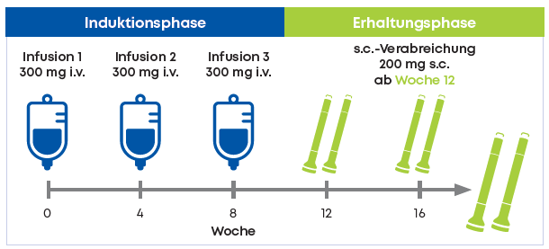
Omvoh dosing begins with 3 induction doses via infusion every 4 weeks and transitions to self-injections for maintenance¹
IV infusions with Omvoh are administered every 4 weeks for 3 doses before transitioning to maintenance dosing at Week 12 for patients who have achieved adequate therapeutic response¹
SC injections every 4 weeks for maintenance are available in a prefilled pen or prefilled syringe, so your patients can take Omvoh wherever is best for them¹
ªFor at least 30 minutes.¹
^{b}If patients do not adequately respond by Week 12 after induction dosing, consider extended induction by administering 300 mg Omvoh by IV infusion at Weeks 12, 16, and 20. If therapeutic benefit is achieved with the additional IV therapy, patients may initiate Omvoh SC maintenance dosing every 4 weeks. Discontinue Omvoh in patients who do not show therapeutic benefit to extended induction therapy by Week 24.¹
IV=intravenous; SC=subcutaneous.
Notes:
Speaker Notes:
The recommended induction dosage of Omvoh is 300 mg administered by intravenous infusion for at least 30 minutes at Week 0, Week 4, and Week 8¹
Omvoh for intravenous use is intended for administration by a healthcare provider using aseptic technique¹
The recommended maintenance dosage of Omvoh is 200 mg administered by subcutaneous injection (given as two consecutive injections of 100 mg each) at Week 12, and every 4 weeks thereafter, with each full dose requiring 2 prefilled pens¹
Omvoh is intended for use under the guidance and supervision of a healthcare professional. Patients may self-inject Omvoh after training in subcutaneous injection technique¹
Reference:
Omvoh Summary of Product Characteristics, Eli Lilly Nederland B.V., Utrecht, The Netherlands; 2023.

Slide 63

Omvoh dosing begins with 3 induction doses via infusion every 4 weeks and transitions to self-injections for maintenance¹
Re-Induction
Erhaltung mit SC
JA
Verliert Ansprechen
JA
NEIN
Induktion mittels Infusionen
Abbruch
Spricht der Patient an?
200 mg (SC) über 2 aufeinander-folgende Injektionen alle 4 Wochen
JA
NEIN
NEIN
Abbruch
Extended Induction
Footnote

Slide 64

Omvoh dosing begins with 3 induction doses via infusion every 4 weeks and transitions to self-injections for maintenance¹
Erhaltung mit SC
JA
JA
Erhaltung mit SC
Verliert Ansprechen
Induktion mittels Infusionen
NEIN
Abbruch
Spricht der Patient an?
Re-Induction
JA
Erhaltung mit SC
NEIN
NEIN
Abbruch
Extended Induction
Footnote

Slide 65
Omvoh dosing begins with 3 induction doses via infusion every 4 weeks and transitions to self-injections for maintenance¹
Erhaltung mit SC
JA
JA
Erhaltung mit SC
Verliert Ansprechen
Induktion mittels Infusionen
NEIN
Abbruch
Spricht der Patient an?
Re-Induction
JA
Erhaltung mit SC
NEIN
NEIN
Abbruch
Extended Induction
Footnote

Slide 66



OMVOH HOHE SELEKTIVITÄT FÜR EINE SICHERE UND ZIELGERICHTETE THERAPIE¹
Summary
Omvoh kann Patient:innen, die bereit sind, auf eine neue UC-Behandlung umzusteigen und deren Alltag durch Stuhldringlichkeit gestört wird, helfen Kontrolle zurückzugewinnen¹
Hohe und anhaltende Remissionraten
50 % aller Patient:innen und 46 % der Patienten mit biologischem Versagen erreichten in Woche 52 mit Omvoh eine klinische Remission im Vergleich zu 25 % bzw. 16 % mit Placebo.¹
Rasche Reduktion der Stuhldringlichkeit
43 % der Patient:innen, die Omvoh einnahmen, erreichten in Woche 52 mit Remission ihrer Stuhldinglichkeit im Vergleich zu 25 % mit Placebo.^{1,2}
Schwere Nebenwirkungen auf Placeboniveau
Die häufigsten Nebenwirkungen, die bei Omvoh beobachtet wurden, waren Reaktionen an der Injektionsstelle, Infektionen der oberen Atemwege, Kopfschmerzen und Hautausschlag.¹
Hypothetical patient.
UC=ulcerative colitis.
Notes:
Claim TK
Speaker Notes
For adult patients with moderately to severely active UC who had inadequate response to their current treatment, make the urgent change with Omvoh¹
Reasons to consider Omvoh include sustained clinical remission, reduction in bowel urgency, and a safety profile from two Phase 3 trials¹
References:
Omvoh Summary of Product Characteristics, Eli Lilly Nederland B.V., Utrecht, The Netherlands; 2023.
Carpio D, López-Sanromán A, Calvet X, et al. Perception of disease burden and treatment satisfaction in patients with ulcerative colitis from outpatient clinics in Spain: UC-LIFE survey. Eur J Gastroenterol Hepatol. 2016;28(9):1056-1064. doi:10.1097/MEG.0000000000000658

Slide 67
FAQ: Warum sind die Placebo-Ansprech- raten in den Mirikizumab-LUCENT-Studien hoch??
FAQ-Backup
Es gibt mehrere Faktoren, die möglicherweise zu den hohen Placebo-Ansprechraten bei klinischen, endoskopischen und symptomatischen Endpunkten in den LUCENT-Studien beigetragen haben¹
Merkmale der Patientenpopulation in bestimmten Ländern, in denen Patient:innen eingeschlossen wurden²
Hoher Einsatz von Kortikosteroiden als Begleitmedikation und kein Ausschleichen während der Induktion³
Lange Induktionsdauer von 12 Wochen für LUCENT-1⁴
Placebo-Erhaltungspatient:innen waren Induktions-Responder¹
Ein hoher Anteil an biologika-naiven Patient:innen nahm an der Studie teil³
Letztendlich ist es nicht möglich, einen einzigen Grund für die hohen Placebo-Ansprechraten, die in den LUCENT-Studien beobachtet wurden zu erklären; der mögliche Einfluss jedes aufgeführten Faktors sollte berücksichtigt werden
1. D’Haens G, et al. N Eng J Med. 2022 (Communicated). 2. Bechman K, et al. J Rheumatol. 2020;47(1):28-34. 3. Macaluso FS, et al. Inflamm Bowel Dis. 2019;25(6):987-997. 4. Jairath V, et al. J Crohns Colitis. 2016;10(5):607-618. 5. Enck P, Klosterhalfen S. Front Pharmacol. 2021;12:641436. 6. Ma C, et al. Aliment Pharmacol Ther. 2018;47(12):1578-1596.
Notes:
Reference(s):
D’Haens G, Dubinsky M, Kobayasi T, et al. Mirikizumab as induction and maintenance therapy for ulcerative colitis. N Eng J Med. 2022 (Communicated).
Bechman K, Yates M, Norton S, et al. Placebo response in rheumatoid arthritis clinical trials. J Rheumatol. 2020;47(1):28-34.
Macaluso FS, Maida M, Ventimiglia M, et al. Factors affecting clinical and endoscopic outcomes of placebo arm in trials of biologics and small molecule drugs in ulcerative colitis: A meta-analysis. Inflamm Bowel Dis. 2019;25(6):987-997.
Jairath V, Zou G, Parker CE, et al. Systematic review and meta-analysis: Placebo rates in induction and maintenance trials of ulcerative colitis. J Crohns Colitis. 2016;10(5):607-618.
Enck P, Klosterhalfen S. The placebo and nocebo responses in clinical trials in inflammatory bowel diseases. Front Pharmacol. 2021;12:641436.
Ma C, Guizzetti L, Panaccione R, et al. Systematic review with meta-analysis: endoscopic and histologic placebo rates in induction and maintenance trials of ulcerative colitis. Aliment Pharmacol Ther. 2018;47(12):1578-1596.
QC completed by Remedica, October 12, 2022. Separate individuals at Remedica (on file) generated the slide (September 12, 2022) and performed data review (October 12, 2022).

Slide 68
FAQ: Was hat es mit dem Leberenzym-Monitoring auf sich?
In den Studien traten bei wenigen Patient:innen Leberenzymerhöhungen auf
Leberenzyme und Bilirubin sollten zu Behandlungsbeginn und monatlich während der Induktion bestimmt werden.
Danach gemäß des Versorgungsstandards überwachen (alle 1-4 Monate)
Wenn (ALT) oder (AST) ansteigen und eine arzneimittelinduzierte Leberschädigung vermutet wird, muss Mirikizumab abgesetzt werden, bis diese Diagnose ausgeschlossen ist.
 | MIRI Induktions Responder
 | PBO SC N=192 | MIRI 200 SC N=389
Leberenzymerhöhungen | 4 (2.1%) | 12 (3.1%)
Footnote
Notes:
Reference(s):
D’Haens G, Dubinsky M, Kobayasi T, et al. Mirikizumab as induction and maintenance therapy for ulcerative colitis. N Eng J Med. 2022 (Communicated).
Bechman K, Yates M, Norton S, et al. Placebo response in rheumatoid arthritis clinical trials. J Rheumatol. 2020;47(1):28-34.
Macaluso FS, Maida M, Ventimiglia M, et al. Factors affecting clinical and endoscopic outcomes of placebo arm in trials of biologics and small molecule drugs in ulcerative colitis: A meta-analysis. Inflamm Bowel Dis. 2019;25(6):987-997.
Jairath V, Zou G, Parker CE, et al. Systematic review and meta-analysis: Placebo rates in induction and maintenance trials of ulcerative colitis. J Crohns Colitis. 2016;10(5):607-618.
Enck P, Klosterhalfen S. The placebo and nocebo responses in clinical trials in inflammatory bowel diseases. Front Pharmacol. 2021;12:641436.
Ma C, Guizzetti L, Panaccione R, et al. Systematic review with meta-analysis: endoscopic and histologic placebo rates in induction and maintenance trials of ulcerative colitis. Aliment Pharmacol Ther. 2018;47(12):1578-1596.
QC completed by Remedica, October 12, 2022. Separate individuals at Remedica (on file) generated the slide (September 12, 2022) and performed data review (October 12, 2022).

